Slide 1
EDUCATION DIVISION
The roles of the University Educators in the Disruptive Era
Professor Maree Dinan-Thompson, DVC Education
James Cook University

Slide 2
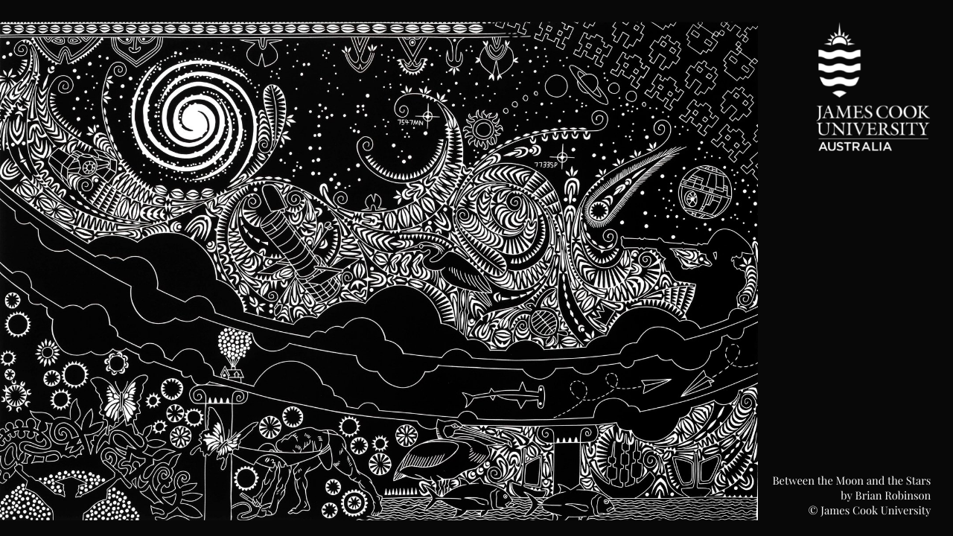
Acknowledgement of Country
At JCU we acknowledge with respect the Aboriginal and Torres Strait Islander people as the first people, educators and innovators of this country.
Today we acknowledge the traditional owners of the lands on which JCU operates in the Cairns region. Towards the mountains and rainforest, the Djabugay People, in the CBD, Gimuy Walubara Yidinji People, and on the coast including the waters in which our research and teaching are conducted, the Yirrganydji People.
The name of our Campus ‘Nguma-bada’ was gifted to the University during our 50th anniversary and means ‘belonging to tomorrow: Place for tomorrow’s learning, knowledge and wisdom’, from the Yirrgay coastal dialect of Djabugay.
I pay my respects to their Elders past, present and emerging. I extend that respect to JCU's distinguished Australian Aboriginal and Torres Strait Islander students, graduates and staff.

Slide 3
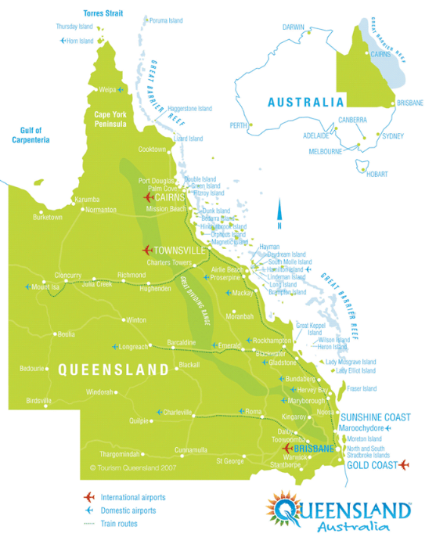
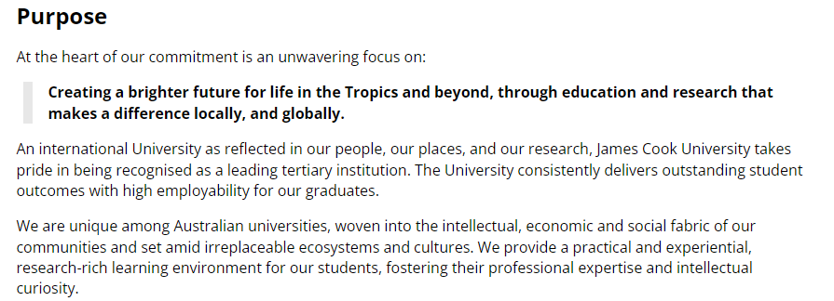
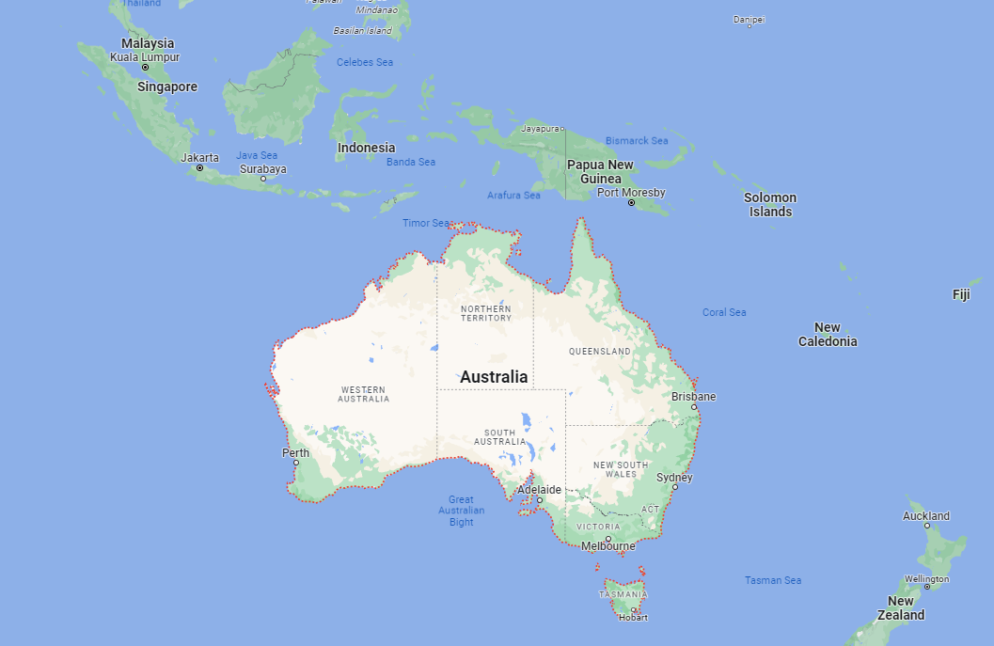
Where is James Cook University ?

Slide 4
Research-intensive universities – commonalities (JCU and Walailak)
Opportunity for research-teaching nexus – invitation for students and others to be engaged in research, relevant and cutting-edge research integrated into subjects and courses.
Opportunity to take advantage of technologies and creativity to challenge knowledge and the ‘expert’ delivery of content and skills.
Opportunity to contribute to economy and drivers for advancement in students’ capabilities and skill development.
Opportunity for communities and industries to be co-joint educators
Reflect for a moment – do these fit with your current roles as educators?
A strong research culture – scholarship, grants and facilities
A focus on innovation and creativity – track record and impact
Academic excellence – rigour, and top talent
Knowledge dissemination and collaboration – conferences, publications, partnerships, institutes
Reputation and impact – national and international – rankings, status

Slide 5
What is the disruptive era in Education?
Flexible and Online Learning: With the development of new technology and the widespread availability of high-speed internet, learners can now access educational content from anywhere in the world at any time. This has brought education to be more accessible and affordable, breaking down barriers to education for learners who would otherwise be unable to access traditional brick-and-mortar institutions.
Personalised Learning: Instead of a one-size-fits-all approach, personalised learning uses technology and data to tailor instruction to individual students' needs and preferences. This can allow students to learn at their own pace, focus on areas they find challenging, and build on their strengths.
Technologies, AI, automation, innovation, start ups: The rise of technology to transform the way we learn and teach, providing new tools, resources, and platforms to support education. Artificial Intelligence platforms (e.g. Chat GPT) are accessible as content creators and will transform assessment methods, and in the future challenge some qualifications that rely on recall of knowledge. The speed at which technologies are advancing content and curriculum is quicker than it is taught in subjects and courses at schools and universities. Start ups and entrepreneurial activity is business as usual in higher education.
Lifetime Learning: Learners need to be able to adapt to new challenges and opportunities throughout their lives. This has led to a shift towards a more flexible, agile approach to education that emphasizes skills development, continuous learning, and upskilling throughout one's career.
Humanness cannot be replaced: the role of humans in education and work is redefined but more important in the digital era, particularly cognitive and social skills.

Slide 6
Thailand 4.0 – what does it mean for educators?
OECD Economics Report 2021 – Thailand’s Education System and Skills Imbalances
Recommends:
Skills development as the driver for Thailand 4.0
Continue efforts to …strengthen the alignment between their study offers and “Thailand 4.0” while modernising teaching methods.
This could involve:
Expanding of skill sets and broadening horizons
Cross-disciplinary moves, secondments, assignments
Students in self-formation rather than just a product of universities
https://one.oecd.org/document/ECO/WKP(2020)49/En/pdf p.44
http://thaiembdc.org/wp-content/uploads/2017/03/thailand-4.0-11-1-e1489780904677.jpg

Slide 7
What else does research tell us about preparation for the disruption era and some gaps?
Quality of graduates – there are declining enrolments and increased competition.
An expectation that research and innovation will lead Thailand to better economic development, however internationally the evidence is slim to say that graduating from universities aligns with a better economy (Marginson, 2023). Students should not be treated as ‘products’ of universities, but that they need to be engaged in a ‘self-formation’ process to participate in their contributions to disciplines, industry and communities.
The OECD report (2020) on Thailand’s higher education and skills imbalances states:
Poor (and declining) reading and writing proficiencies even though funding in primary education is highest in the comparative region
There is an ageing population and lifetime learning will need to be a focus on upskilling and reskilling. In particular engaging women, older workers, low-skilled workers, and increasing access for poor families and taking education to regions. A focus on career guidance and career development will be key in higher education institutions as it is suggested that there is a ‘mismatch’ between students and their careers.
That qualified workers are more valued in industry than higher education, and that universities fall behind in producing relevant skills for the private sector.
From the report (p.32) : The shortages observed at the occupational level translate into shortages of cognitive skills, such as mathematical reasoning, writing and reading comprehension, but also certain social skills, like service orientation, and technical skills (e.g. programming and technology design). The knowledge areas found to be most in shortage are ‘computers and electronics’, ‘clerical knowledge’ and ‘customer and personal service’. As Thailand continues to be exposed to global mega-trends, such as population ageing, globalisation and automation, shortages of high-level cognitive skills and social skills are likely to become even more pronounced, as is the case in many OECD countries today.
(https://one.oecd.org/document/ECO/WKP(2020)49/En/pdf)

Slide 8
A musing for you to consider:
Higher education cannot create a profitable economy directly. What it does is help to form people who can do many things, including the creation of economic value. To those who argue that higher education should focus on employability the answer is this. Graduates maximise their own employability when they have enhanced personal agency, permeated by knowledge and sustained by the capacity to continually learn and develop themselves reflexively.
All of the ‘generic’ skills – flexibility and adaptability, initiative, communication, working in teams, creativity and lateral thinking – are skills of the self-forming reflexive person with agency freedom. These skills are real, except they are not solely generic. They are acquired through immersion in knowledge and never content free or context free. The creativity of the mathematician, the engineer, the linguist and the lawyer all entail creation, but the imaginings, discourses and applications are distinct.
(Callender, Locke & Marginson, 2020, p.82)

Slide 9
So… Is the role of educators becoming obsolete in the face of technological disruption in education, or are they more important than ever?

Slide 10
Who are educators? What are our roles?
Traditionally, universities have academic staff that are lecturers and researchers, and supported by professional and technical staff. There is also a role to play in engagement with community and industry.
From our work in Australasian professional learning and capability development for university educators:
Educators are learners and leaders
Learning and teaching is practice and evidence-based
In the new ways of defining University educator roles in the disruptive era, they include academic roles, part-time and sessional teaching, professional and technical positions, research supervision, clinical, laboratory, workshop, studio, field and work-based teaching, industry and advisory, and team-based contributions. Some other researchers talk of a ‘third space professionals’ (Whitchurch, 2015) and the changing nature of academic work.
(Dinan-Thompson, Lynch, Cowden, Bedford, Branigan, Cary, Johnston, Luzeckyi and Saliba, 2022, https://jcu.pressbooks.pub/tcaue/)

Slide 11
Changing Educator roles
In a workforce study in Australia in 2016, university leaders they spoke to are seeking a ‘workforce with skills that are transferable across boundaries’ such as those between disciplines and sub-disciplines and between universities and industry ( PWC/AHEIA 2016, p.22).
However, a challenge is to create ‘a more delicate balance in optimizing individual aspirations and institutional missions in higher education’ (Callender, Locke & Marginson, 2020, p.28). And that, ‘perhaps most important of all, our analyses can acknowledge the active role that universities and the scholars [educators- my insert] they house – often in collaboration with others – play in initiating and directing many of the intellectual, social, technological and environmental innovations that will shape the future, not just of higher education but of societies in general’ (2020, p.29).

Slide 12
So how do we do this? We need to know our students and build capabilities
Students are learners and customers
They are influenced by intrinsic and extrinsic factors
Intrinsic – self interest, passion, and social accountability
Extrinsic – employment, status, social power of a university
They are sometime underprepared:
Writing and reading are shown to be areas of development (not deficit) and it is our responsibility to build the capability within our disciplines
We may need to take the learning to them
Upskill and reskill agendas will bring new approaches, and equity and regionality are important
Self-formation is essential and as educators we facilitate this development

Slide 13
So how do we do this? We need to know what self-formation is and how it relates to our own teaching and our university
A concept: Higher education can be understood as a process of self-formation or self-cultivation, immersed in complex knowledge, that enables the student to become more capable and more autonomous and self-determining (Marginson, 2018).
Self-formation is touched in all the institutions, professional environments, public places, activity groups, and private settings; by all locations in which identity is invested and action is shaped; by cross-cultural encounters, material economics, policy and regulation, and other relations of power (Marginson, 2014, p. 14).
The task of teachers [educators – my insert] and institutions is not just to provide resources but to persuade students to join their project making – including themselves as project – to the curriculum (Marginson, 2023, p.80).

Slide 14
So how do we do this? We need to know what self-formation is and how it relates to our own teaching (and to ourselves)
Self-formation is achieved through these elements:
Autonomy – learners have agency, are self-directed and participate in conscious action.
The will to learn – the intersection of intrinsic and extrinsic factors and that the learner does the learning (they are not empty vessels)
Reflexive agency – this allows a learner to see ‘who I am’, ‘who I am becoming’, and ‘what I want to be’
Immersion in knowledge – in disciplines, in research, in community and industry as well as sharing in and outside of classrooms
(Marginson, 2023, p.80).

Slide 15
So how do we do this? We bring ‘humanness’ to education in new ways
Human-centred learning is:
accessible – opportunity to learn, easy to navigate, WCAG 2.0, scaffolded
Inclusive – diversity is welcomed, perspectives are at asset
enjoyable – fun to learn, shared purpose, interactive but also challenging
connected – to student experiences and futures
leads to change – to transform self so reflection is needed
(adapted from Vojnovski, 2022)
Students are not objects or products.
Higher education enables people to transform themselves through
never-ending work
‘of the self on the self’ (Marginson, 2023, p. 61).

Slide 16
So how do we do this? We create the research-teaching nexus in our subjects and classes (and you may be doing this already)
We:
draw on personal research in designing and teaching courses
place the latest research in the field within its historical context in classroom teaching
design learning activities around contemporary research issues
teach research methods, techniques and skills explicitly within subjects
build small-scale research activities into undergraduate assignments
involve students in departmental research projects
encourage students to feel part of the research culture of departments
infuse teaching with the values of researchers, and
conduct and draw on research into student learning to make evidence-based decisions about teaching
join with industry and promote engagement in and out of the classroom
https://melbourne-cshe.unimelb.edu.au/__data/assets/pdf_file/0006/1761207/TR_Nexus2005.pdf(Baldwin, 2005)

Slide 17
So… If educators are more important than ever, what do we as educators need to do to prepare and enhance self-formation?

Slide 18
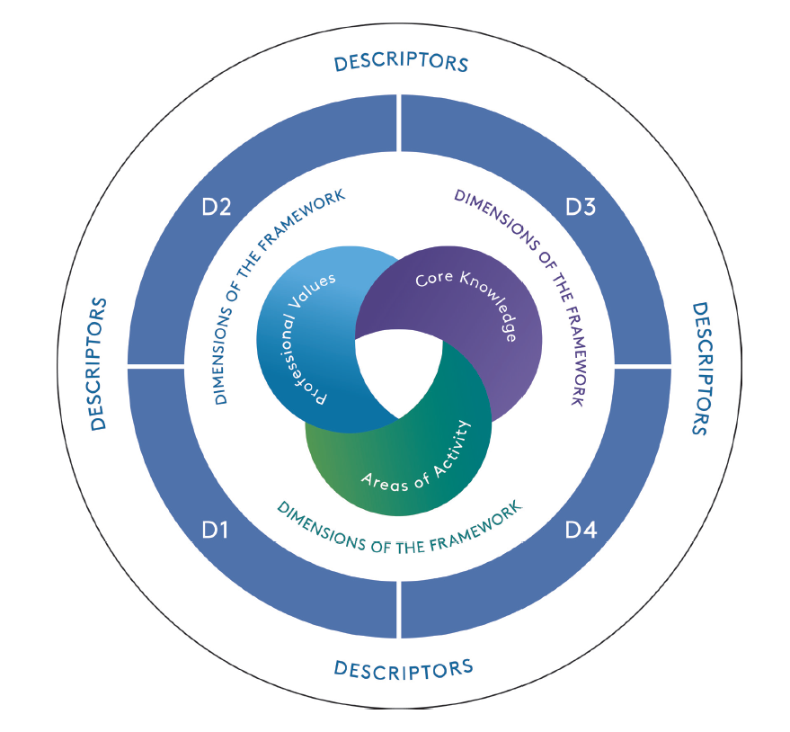
UKPSF 2023, p.3
However,
We learn more from people who challenge our thought process than those who affirm our conclusions.
(Adam Grant, 2021)

Slide 19
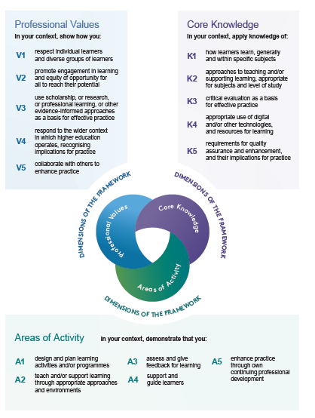
A reminder of the values, core knowledge and areas of activity
(UKPSF, 2023, p.5)

Slide 20
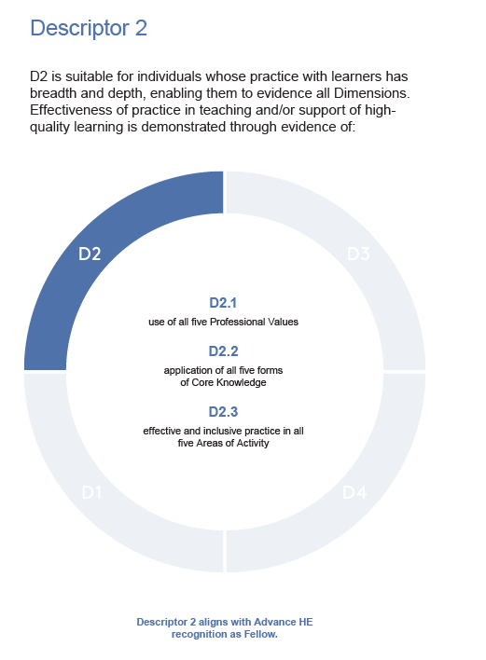
Walailak University – 90% Fellows
A foundation has been laid for learners and educators at WU, but it is only the start!
…. to undertake the role of educators in the Disruption Era you will need to take risk, to move into new areas of skills and development, to mobilise each other’s strengths (and this includes a focus on learners and their strengths).

Slide 21
As an educator I will need to:
Embrace innovation: The disruption era in education is bringing about rapid changes, and educators must be willing to embrace new approaches and technologies to stay relevant. This may involve exploring new teaching methods, using educational technology, or adapting to new learning environments.
Focus on skills development: As the job market continues to evolve, educators must prioritise teaching the skills that learners need to succeed in their careers. This may include digital literacy, critical thinking, collaboration, and problem-solving skills.
Foster lifetime learning: With the pace of change accelerating, lifelong learning is becoming more important than ever. Educators must encourage learners to develop a growth mindset and a love of learning that will serve them well throughout their lives.
Emphasize the human element: While technology can be a powerful tool in education, it's important not to lose sight of the human element. Educators should focus on building strong relationships with their learners, creating a sense of community, and providing personalised support and guidance.

Slide 22
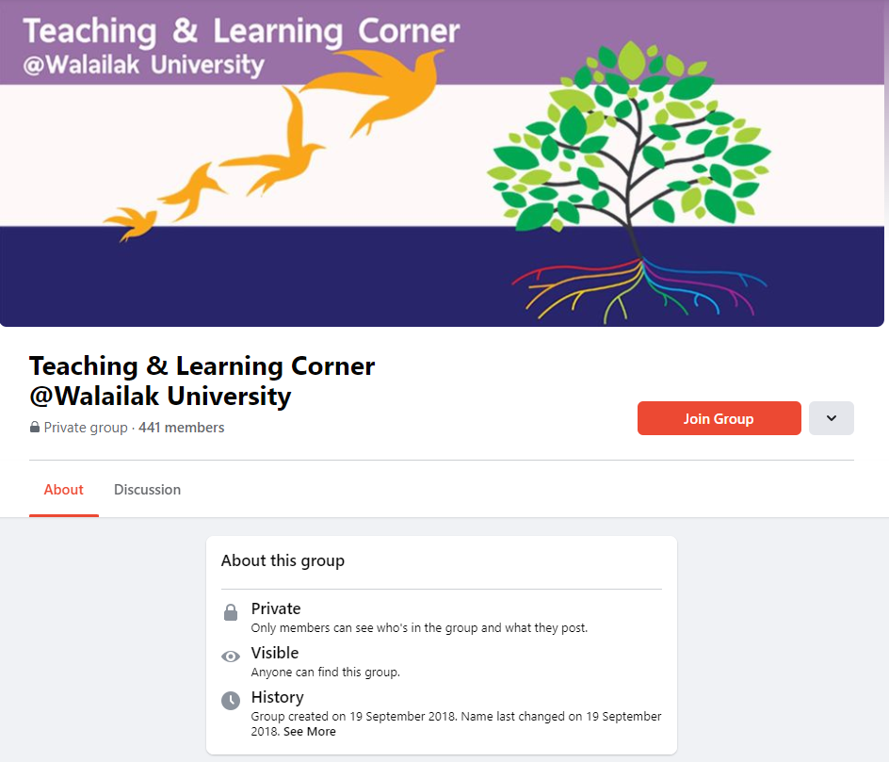
What can you do?
Join the Teaching & Learning Corner @ Wailailak University
A community of practice to support and challenge self-formation.
https://cte.wu.ac.th/ukpsf.php

Slide 23
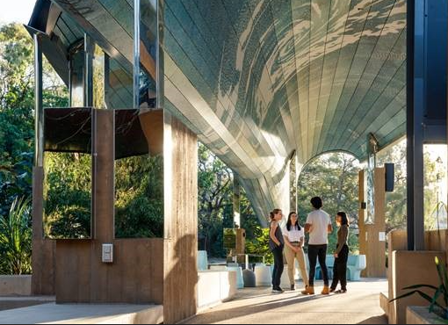
Prof Maree Dinan-Thompson
dvceducation@jcu.edu.au

Slide 24
Reference List
Advance HE, Guild HE and Universities UK (2023) Professional Standards Framework for teaching and supporting learning in higher education. Accessed 14 February 2023 https://advance-he.ac.uk/knowledge-hub/professional-standards-framework-teaching-and-supporting-learning-higher-education-0?_ga=2.193991981.1470844615.1679910295-1533489030.1679462093
Australian Higher Education Industrial Association (AHEIA) ( 2016). Australian Higher Education Workforce of the Future Report Accessed 1 March 2023 https://aheia.edu.au/wp-content/uploads/2021/12/aheia-higher-education-workforce-of-the-future-report.pdf
Baldwin, G. (2005) Teaching-Research Nexus. Centre for Higher Education, The University of Melbourne. Accessed 14 February 2023 http://www.cshe.unimelb.edu.au/
Baskoro, G. (2018). Challenges and Opportunities of Higher Education Institution in the disruption era towards Education 4.0. Technoplex – 2018 Institut Teknologi Indonesia. ISSN: 2654-489X
Callender, C., Locke, W., & Marginson, S. (Eds.). (2020). Changing higher education for a changing world. Bloomsbury Publishing Plc.
Dinan-Thompson, Lynch, Cowden, Bedford, Branigan, Cary, Johnston, Luzeckyi and Saliba, 2022, https://jcu.pressbooks.pub/tcaue/
Grant, A. (2021) Think Again. Accessed 1 March 2023 https://adamgrant.net/book/think-again/
Lubis, F. (2019) Education in the Disruption Era. Britain International of Linguistics, Arts and Education (BIoLAE) Journal ISSN: 2685-4813 (Online), 2685-4805 (Print) Vol. 1, No. 2, November 2019, Page: 183-188.
Marginson, S. (2014). Student Self-Formation in International Education. Journal of Studies in International Education,18 (1), pp.6-22.
Marginson, S. (2018) Higher education as self-formation. Inaugural professorial lecture at the UCL Institute of Education. https:// www .ucl -ioe -press .com/ books/higher -education -and -lifelong -learning/ higher -education -as -a -process -of -self-formation/
Marginson, S. (2023) Higher Education as student self-formation. Accessed 25 March 2023 https://www.elgaronline.com/edcollchap-oa/book/9781035307173/book-part-9781035307173-12.xml
OECD (2020). Thailand’s Education System and Skills Imbalances: assessment and policy recommendations. Accessed 20 February 2023 https://one.oecd.org/document/ECO/WKP(2020)49/En/pdf
Puriwat, W. & Tripopsakul, S. (2020). Preparing for Industry 4.0 – Will youths have enough essential sills?: An Evidence from Thailand. International Journal of Instruction, Vol 13, No. 3, pp 89-104 E-ISSN: 1308-1470
Somabut, A. & Tuamsuk, K. ( ) Online Teaching and Learning Ecology in Thai Higher Education during the COVID-19 Pandemic. In Higher Education - New Approaches to Accreditation, Digitalization, and Globalization in the Age... DOI: http://dx.doi.org/10.5772/intechopen.100222.
Thailand 4.0 http://thaiembdc.org/wp-content/uploads/2017/03/thailand-4.0-11-1-e1489780904677.jpg
Vojnovski, T. (2022) 4 Truths of Human-Centred Learning Design https://elearningindustry.com/truths-of-human-centered-learning-design
Whitchurch, C. (2015). The Rise of Third Space Professionals: Paradoxes and Dilemmas. In: Teichler, U., Cummings, W. (eds) Forming, Recruiting and Managing the Academic Profession. The Changing Academy – The Changing Academic Profession in International Comparative Perspective, vol 14. Springer, Cham. https://doi.org/10.1007/978-3-319-16080-1_5

