Slide 1



Reinventing Higher Education in the Disruptive World :
Science, Innovation and Talents
Kitipong Promwong & Tidarat Komolwanich
President Policy Specialist
Office of National Higher Education Science Research and Innovation
Policy Council, NXPO
Walailak Research Convention 2023, “Higher Education in the Disruptive Era”
28 March 2023

Slide 2

Thailand at Its Greatest Extent
1^{s t} ( B a n g k o k ) & 10 ^{t h} (Phuket)
b e s t w o r k a t i o n c i t y (2021)
5^{t h} b e s t w o r l d c u l t u r a l h e r i t a g e
i n f l u e n c e ( 2021 )
5^{t h} s t r o n g e s t h e a l t h security (2021)
1^{s t} a c h i e v e d h i g h e s t d i g i t a l
c o m p e t i t i v e n e s s r a n k i n g ( 2021 )
7 ^{t h} r e s i l i e n c y a n d m o m e n t u m
f o r f u t u r e g r o w t h ( 2022 )
1^{s t} b e s t c o u n t r y t o s t a r t a b u s i n e s s ( 2020 )
8 ^{t h} b e s t i n t h e A s i a t o s t u d y a b o a r d ( 2023 )
2^{n d} b e s t c o u n t r y t o i n v e s t i n
( 2020 )
8 ^{t h} b e s t c o u n t r y f o r e x p a t s ( 2022 )
2

Slide 3






Thailand Grand Challenges
Aging Society
Technological Disruption
Geo-Politics
Urbanization
Climate Change & Pandemics
Heterogeneity & Customization
Energy, Food & Water Scarcity
3

Slide 4
Middle Income Trap
Exponential Growth
Source: https://data.worldbank.org/
4

Slide 5
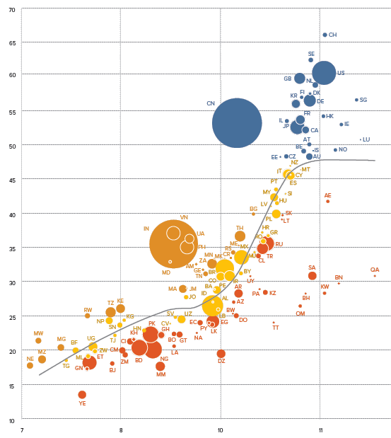
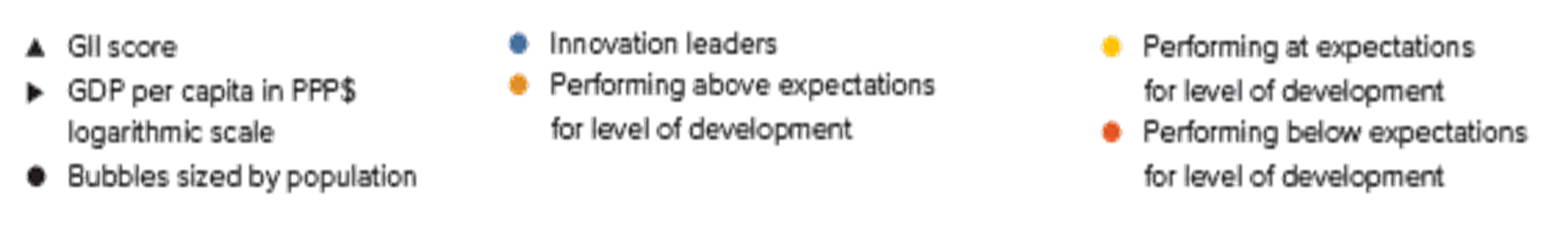

Thailand in the Global Innovation Ecosystem
THAILAND
GDP per Capita
Sources: Global Innovation Index 2020, Cornell, INSTEAD and WIOP 2020.
Global Innovation Index Score
5

Slide 6




Current Keys Policy Direction
HE&I support to enable Thailand towards to
High Income Country
HE&I support to enable Thailand to achieve carbon neutrality and net zero emission of GHG
Social Mobility and Targeting Poverty Eradication
Innovation Driven Enterprises (IDEs) Acceleration
Drive Creative Economy from Cultural Heritage
GHG Net Zero Innovation Platform
Circular Economy Innovation Ecosystem: Vision 2030
1 Million Vulnerable People in 2027
Higher Education Transformation for High-skilled Workforce Development
to Support Strategic Industries and Frontier Technolgy
University Capability Building and Reinventing Higher Education System
Frontier Research to Foster Innovation and New Discovery
6

Slide 7
HE&I support to enable Thailand towards to
High Income Country
7

Slide 8





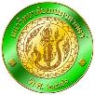















1,000 IDEs with THB 1-billion revenue
1,000
IDEs
Goal: 1,000 innovation-driven enterprises (IDEs) with more than THB 1-billion revenue
100
IDEs
University Holding Company
In-Wall
+others
400
IDEs
Regional Science Parks’ Networks:
Logistic & Warehouse Management
Commercial
Human Resource
To incubate and accelerate innovative entrepreneur in the R1
Policy proposal : “Development of R1 Economic Innovation Corridor”
Mae Khong-Lan Chang Fund
ECIP
Export product to China and CLMV market
Financing and investment
500
IDEs
Out-Wall
Deep Tech
Creative
Service
OTOP
8

Slide 9


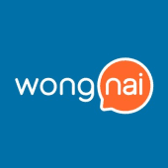









Currently, Thailand has the deepest round of funding in Series E.
The fundraising from Series C upwards is still mainly concentrated in Logistic and Fintech groups.
Series | Pre-Seed/Seed | Series A | Series B | Series C | Series D | Series E
No. of Deals | 373 deals | 100 deals | 36 deals | 7 deals | 3 deals | 1 deals
Value ($m) | 143M | 357M | 298M | 299M | 242M | 150M
Avg size ($m) | 0.4M | 3.5M | 8.3 M | 42.8M | 80.7M | 150M
Time since founded Avg no. of investors | 2.5 Yr 1.5 | 3.8 Yr 2.4 | 6.0 Yr 2.5 | 6.2 Yr 4.2 | 5.5 Yr 2.7 | 4.4 Yr 6.0
9
ที่มา: Crunchbase as of Mar 2022

Slide 10


UHC : 6 universities and company/startup/spin-off : 42 companies
CU Enterprise
ANG KAEW HOLDING COMPANY LIMITED
M VENTURER
COMPANY LIMITED
NAWAWIWAT COMPANY LIMITED
TUIP
K UNIVERSE COMPANY LIMITED
CHULA 99.8%
Registered capital 220 MB
CMU 49%
Foundation CMU 40%
Suan Dok Hospital Foundation 11%
Registered capital 1 MB
MU 90%
Registered capital 3 MB
Foundation KMUTT 99.96%
Registered capital
0.25 MB
TU 98%
Registered capital
1 MB
Registered capital
1 MB
University’ Investment
University executives as executive committee of the company
University Council Committee as executive committee of the company
University executives as executive committee of the company
University executives as executive committee of the company
University executives as executive committee of the company
University executives as executive committee of the company
Management
How to Investment
Funding
and IP
IP
Funding
and IP
IP
IP
N/A
Company
22 companies
9 companies
2 companies
8 companies
1 company
N/A
10
Other universities in the process of studying the establishment UHC ex. Thaksin University, Maejo University, Naresuan University

Slide 11

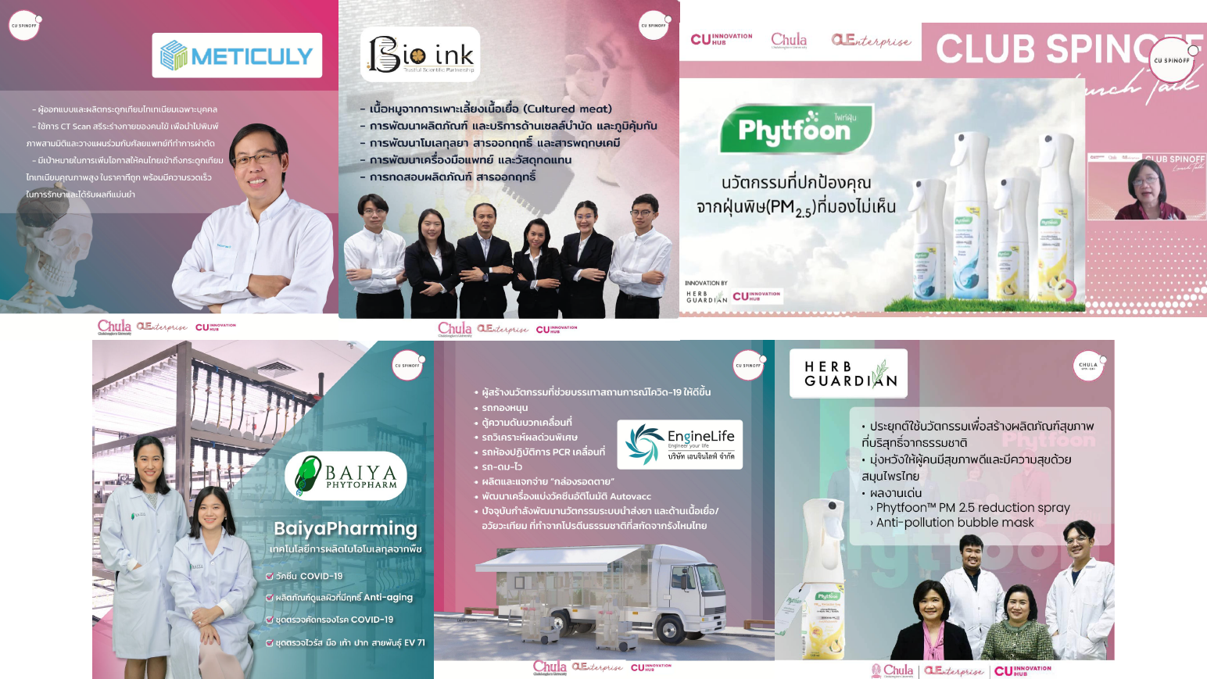


Example of University Holding Company and Spin-off Company
Source: CU Enterprise, www.prachachat.net, edunewssiam.com
11

Slide 12

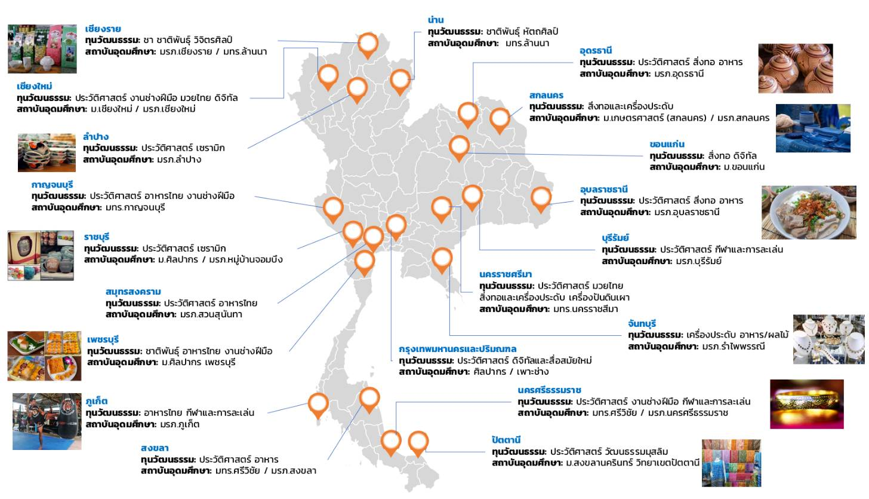
Drive Creative Economy from Cultural Heritage
12

Slide 13


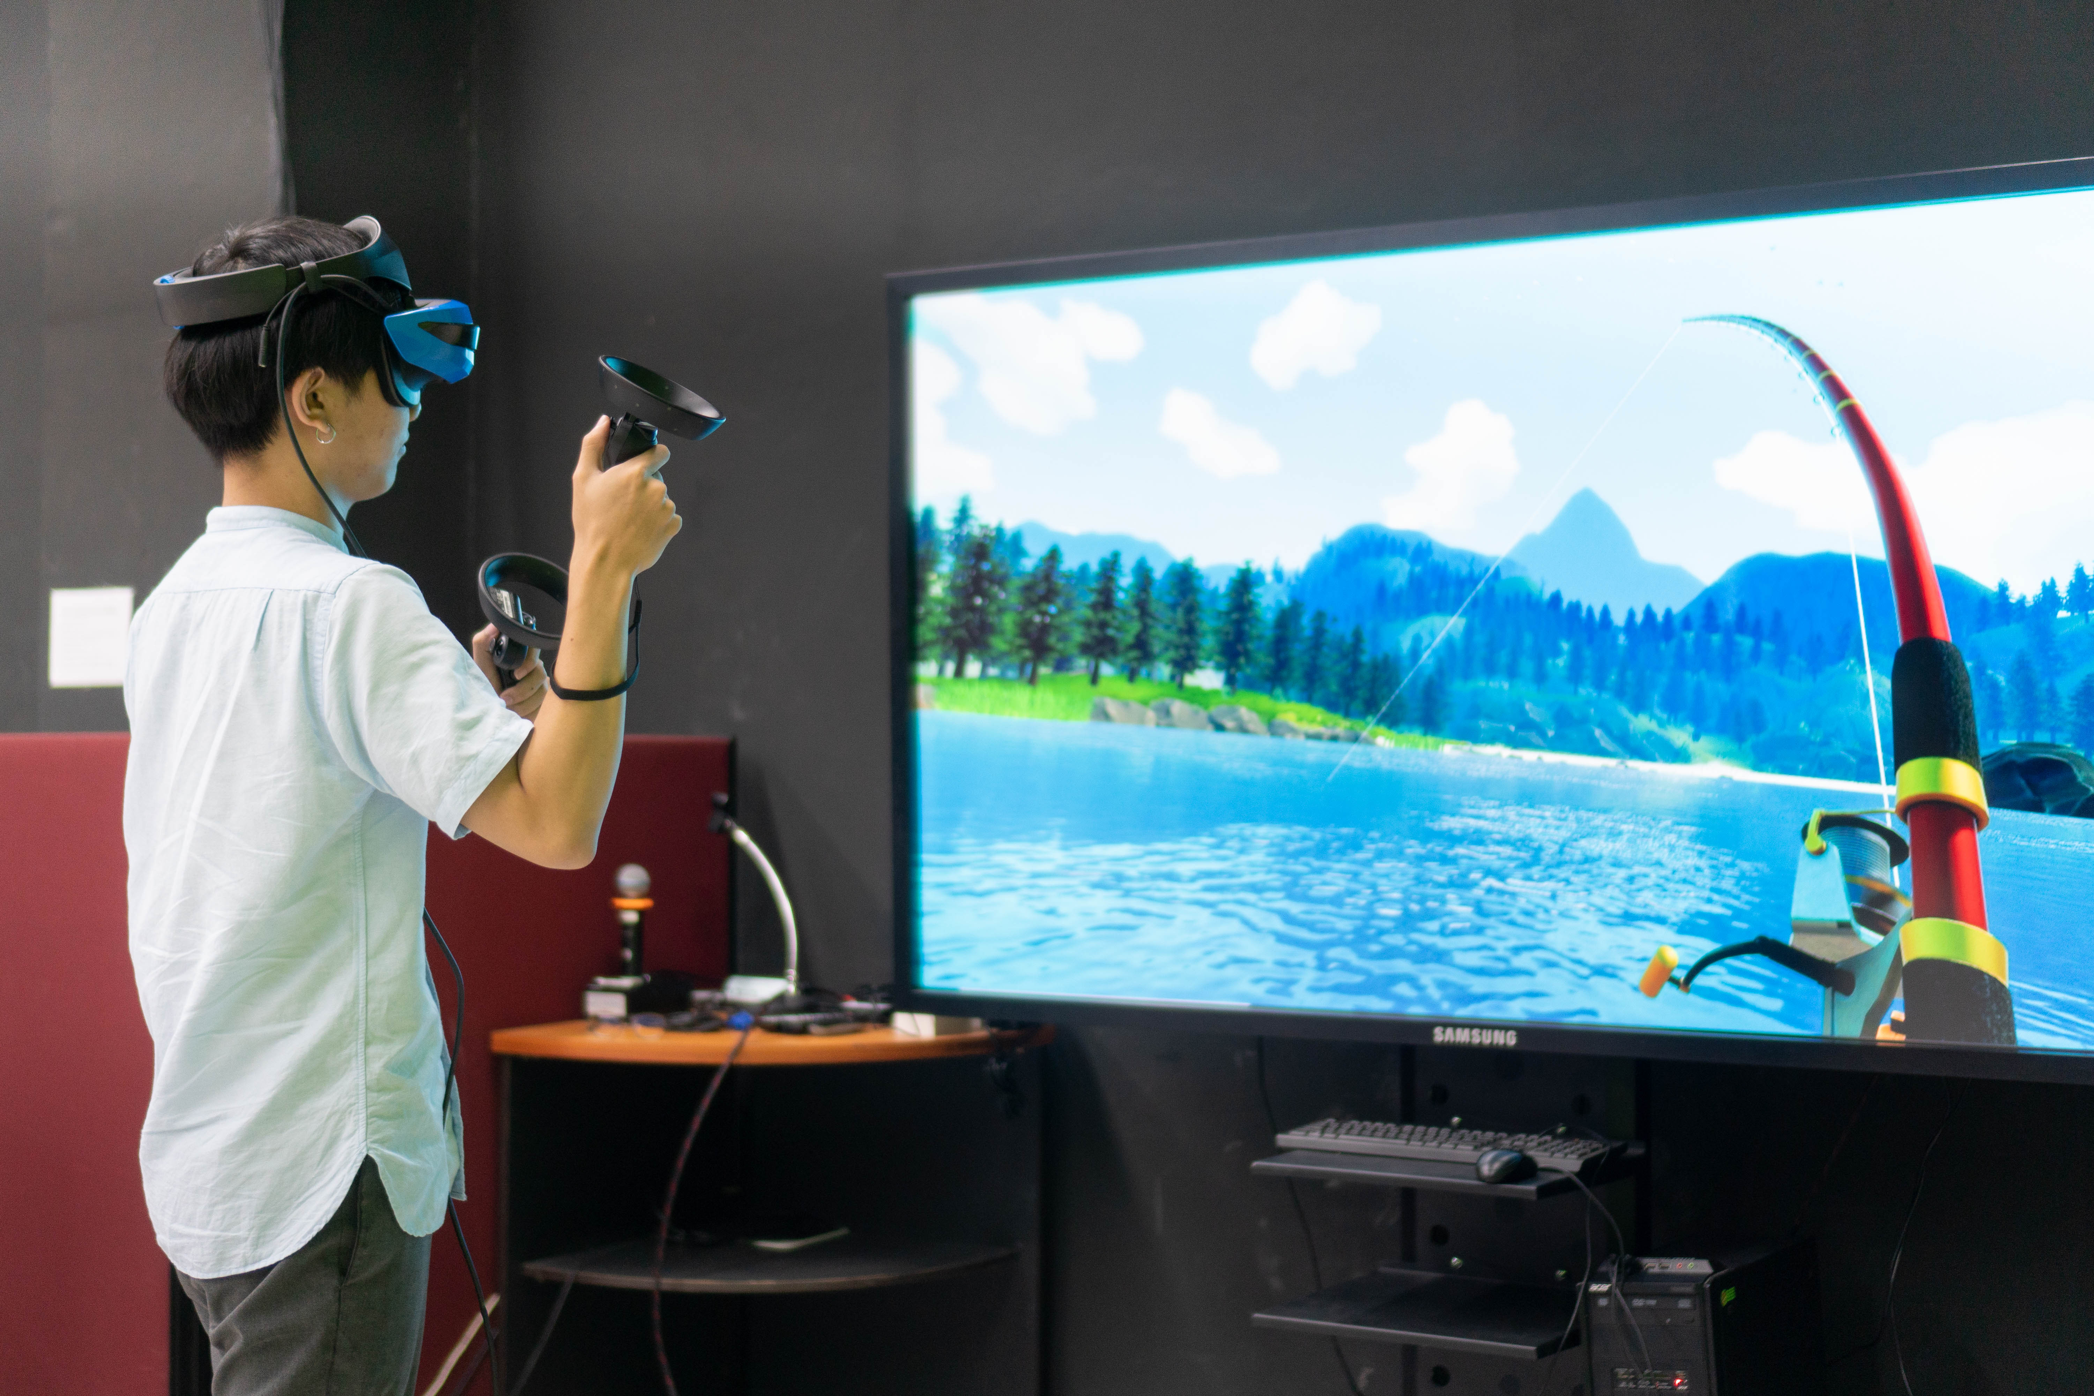
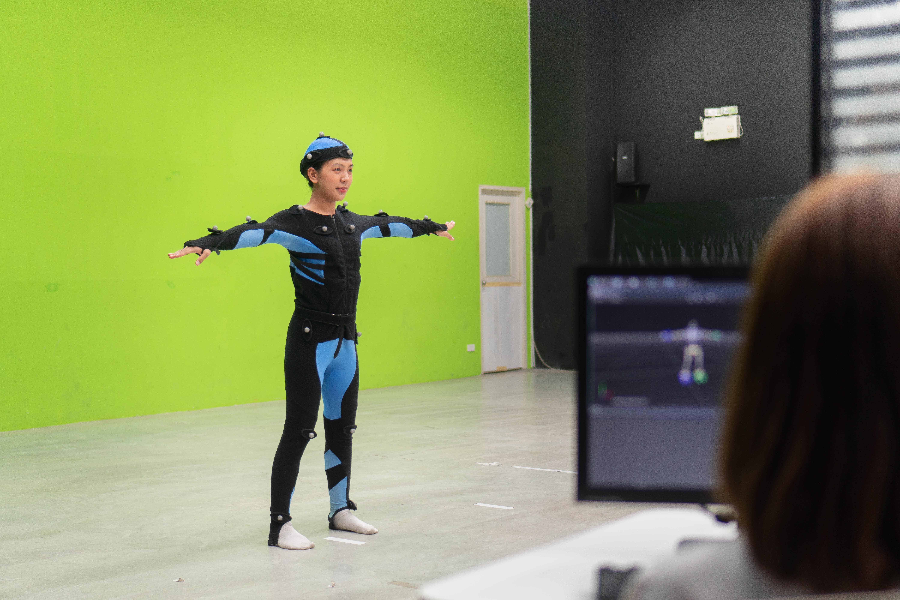
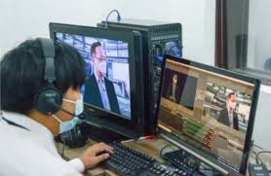
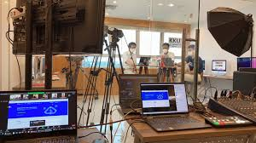
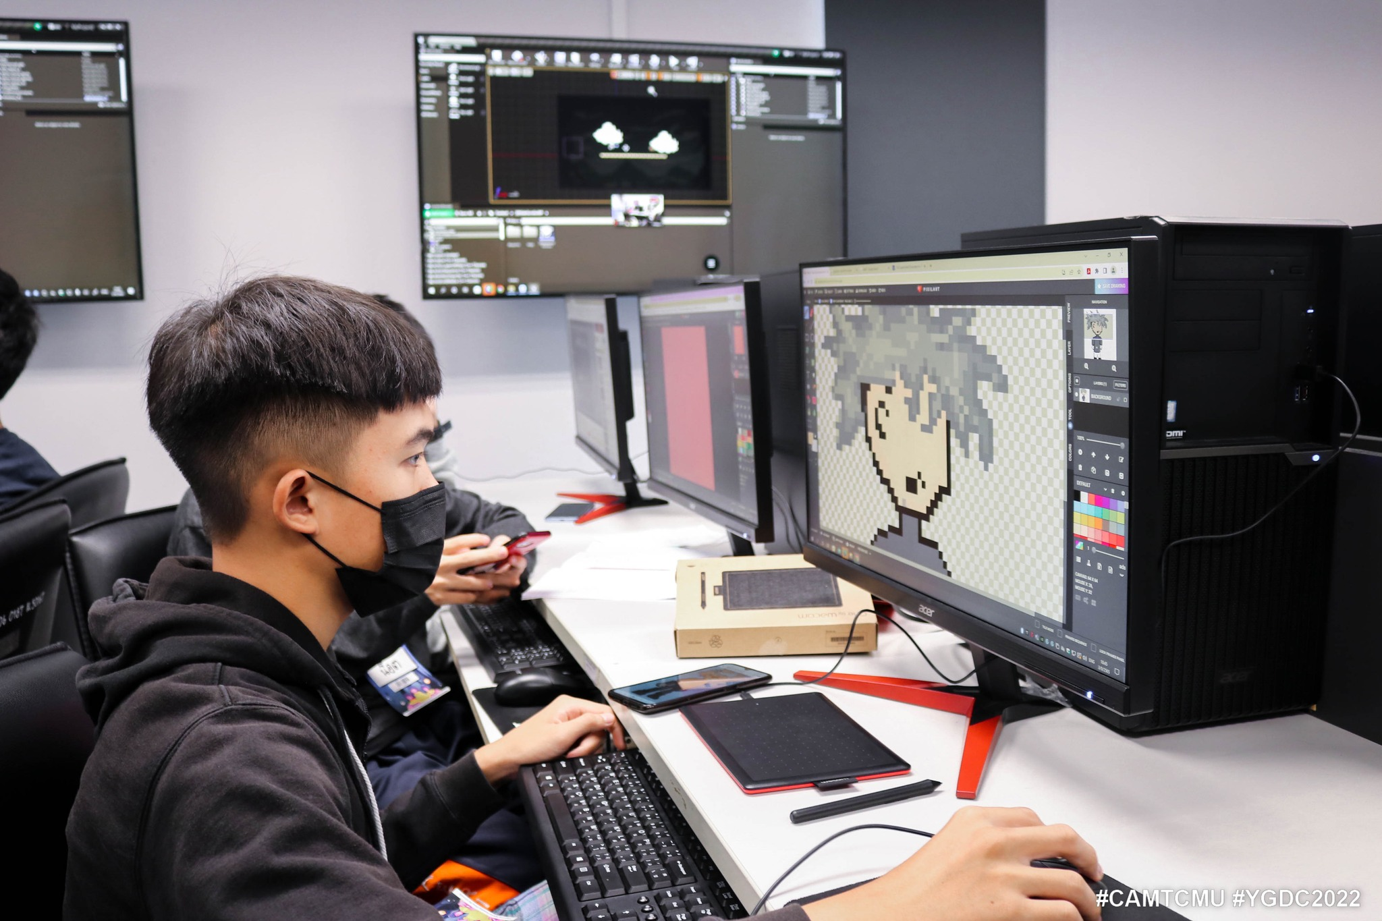
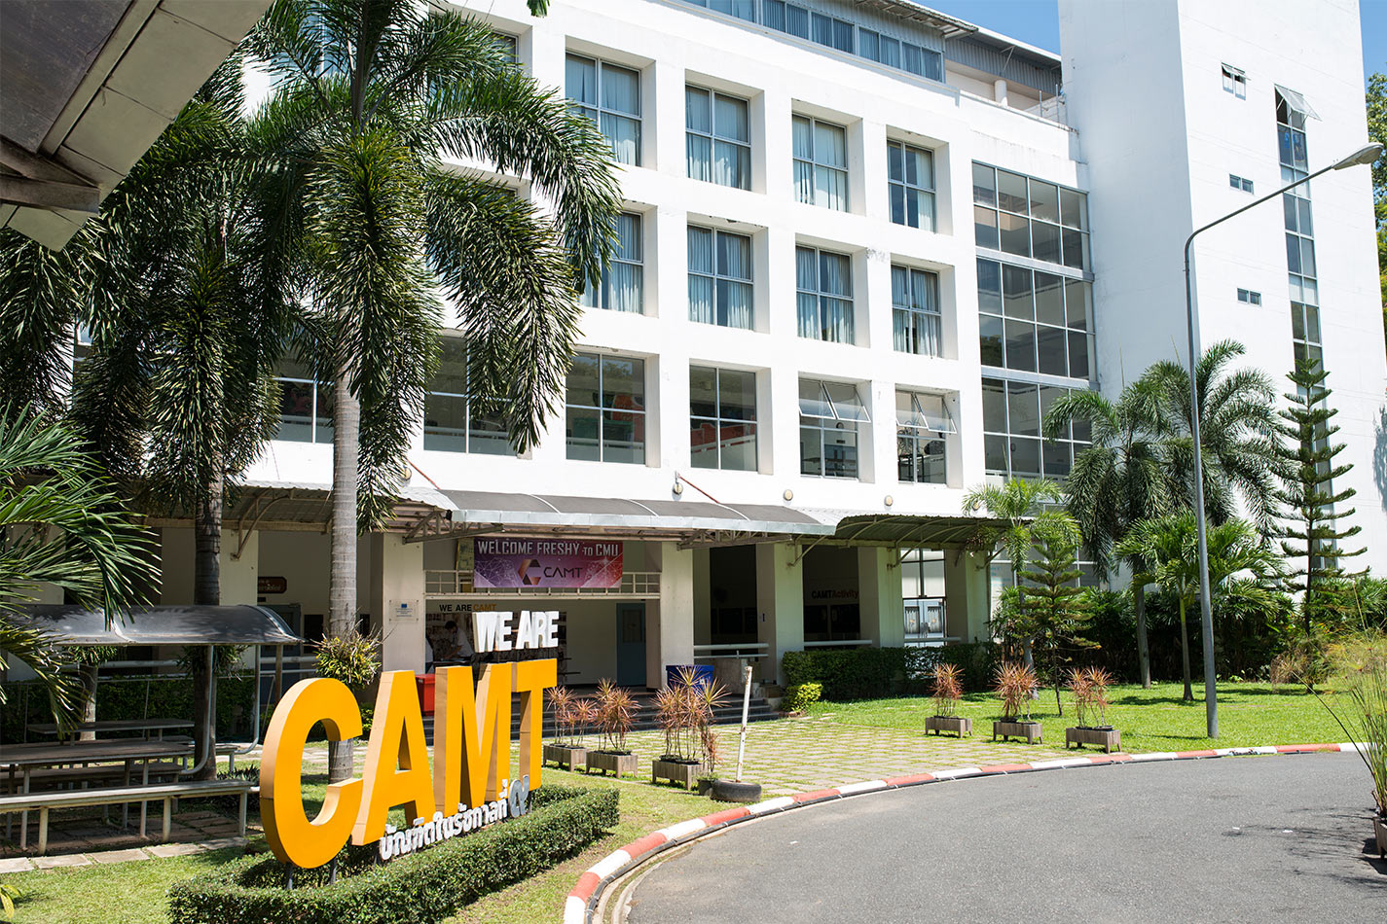
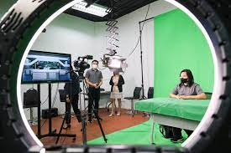
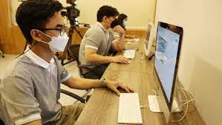
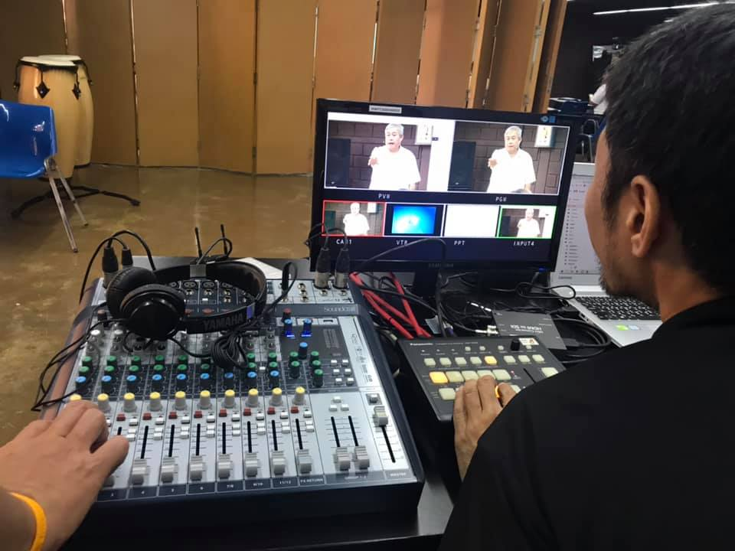
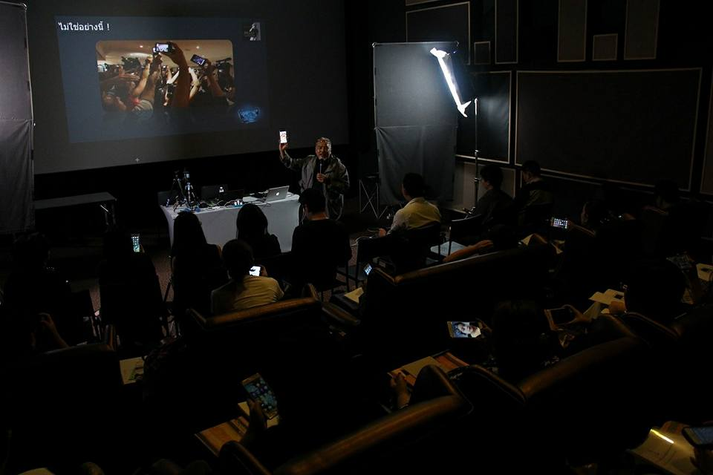
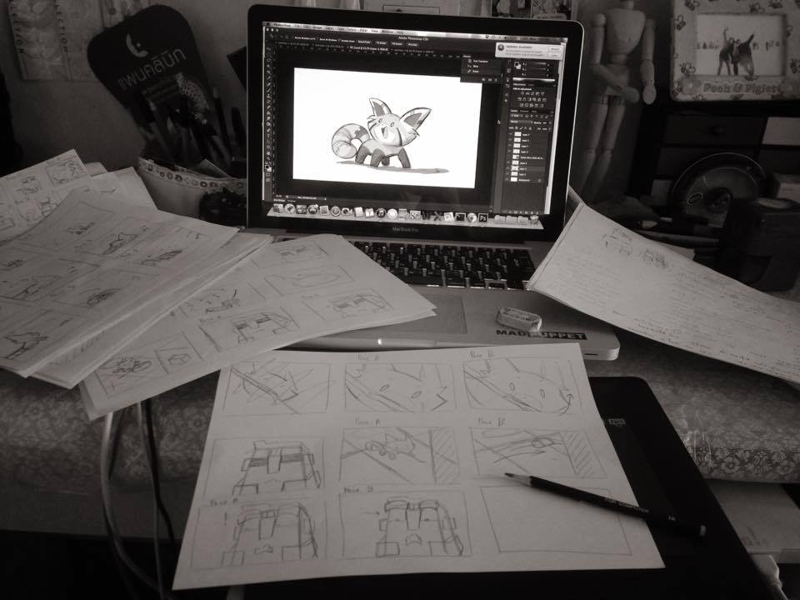
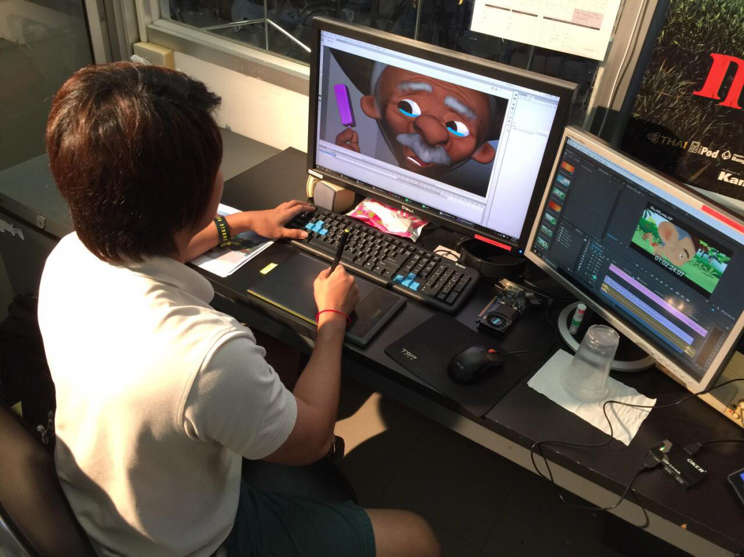
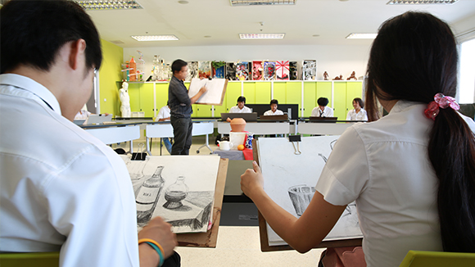
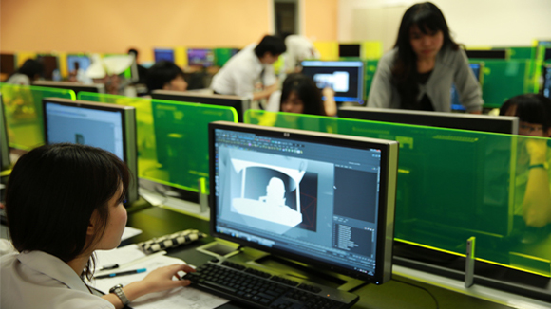
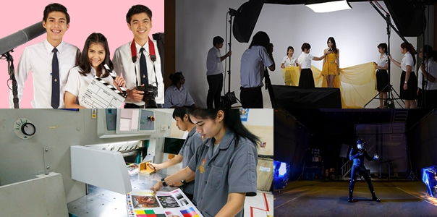
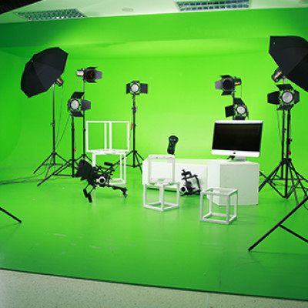
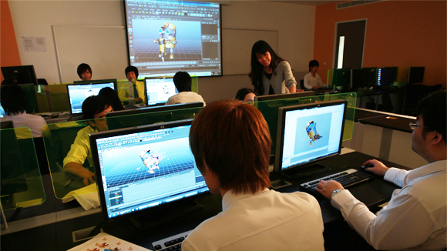
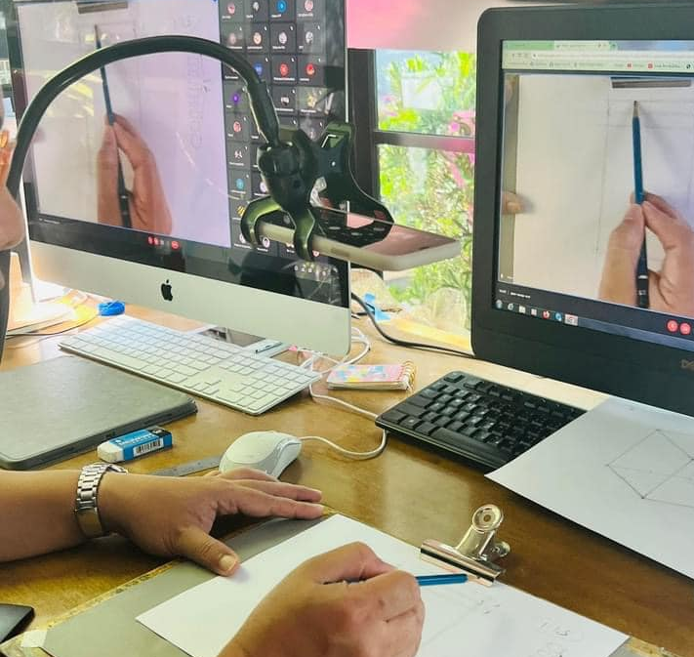
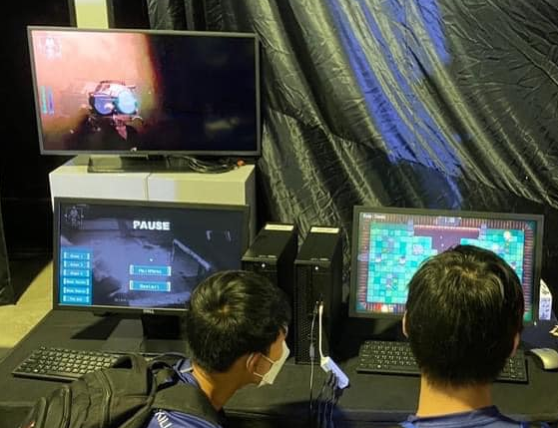


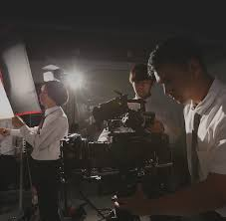
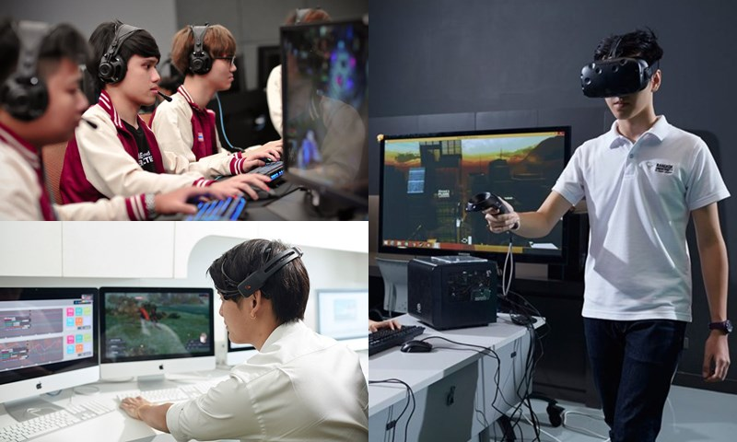
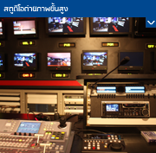
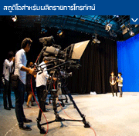


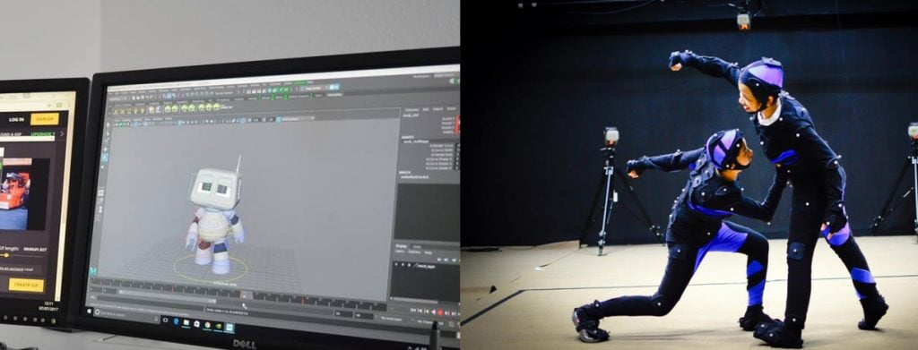
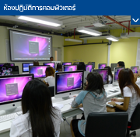

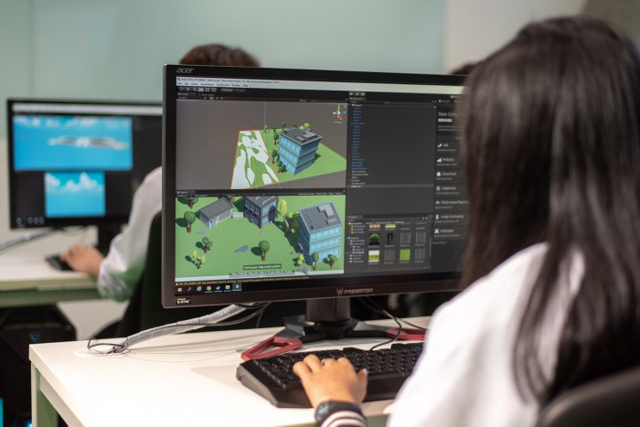
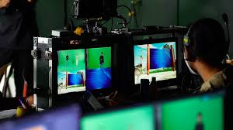
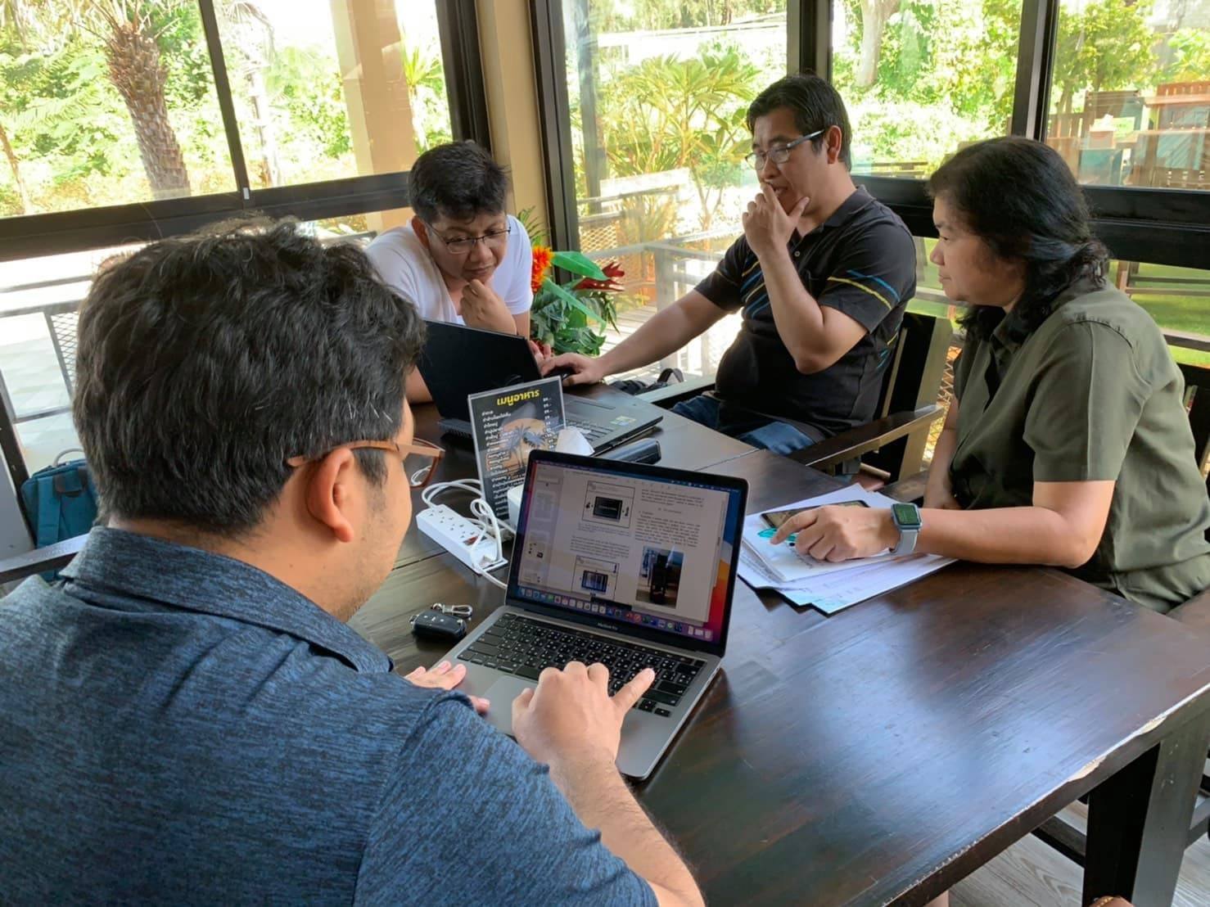
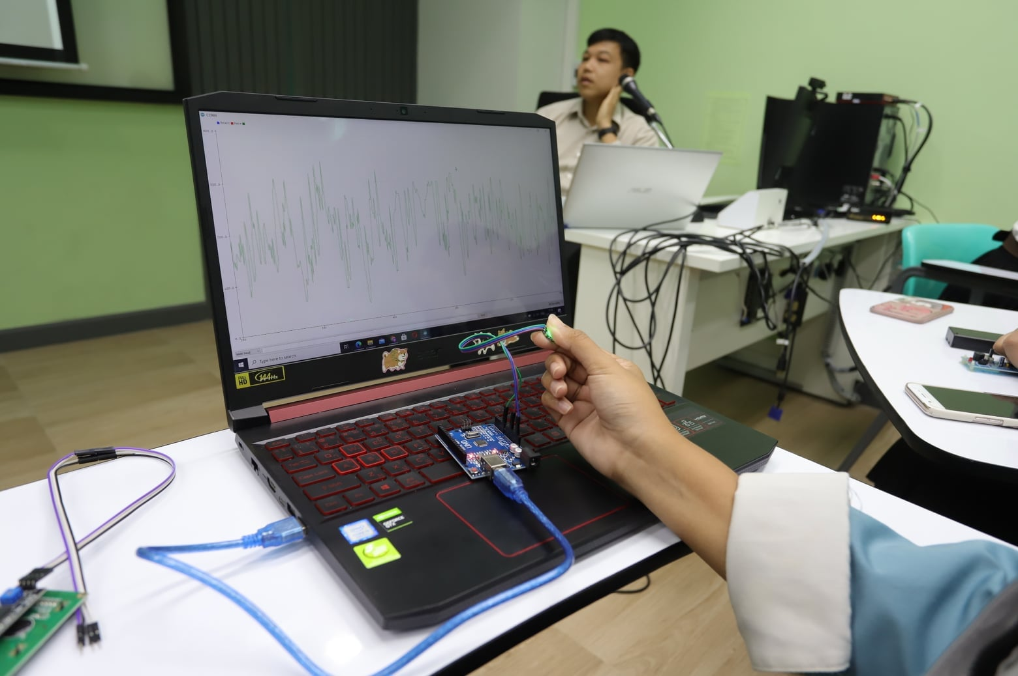
Creative Content Innovation Labs
Chiang Mai
Khon Kaen
Faculty of Mass Communication Technology, Rajamangala University of Technology Thanyaburi
Kantana Institute
Pathum Thani
School of Digital Media, Sripatum University
Nakhon Pathom
Phetchaburi
Bangkok
Faculty of Information and Communication Technology, Silpakorn University
School of Information Technology and Innovation, Bangkok University
College of Communication Arts, Rangsit University
Nakhon Si Thammarat
School of Infomatics Walailak University
หมายเหตุ: ภาพจากสื่อประชาสัมพันธ์ของหน่วยงาน
13

Slide 14




















Policy Proposals to Drive Creative Economy from Cultural Heritage
Manpower & Career Development
Increase 1,000 Creative Content/Digital Media Personnel per Year
Upskill-reskill 100 Workforces in Media Industry per Year
Specialized Course of Arts, Aesthetics and Civilization
Establish Specialized Higher Education Institution of Arts, Aesthetics and Civilization (Poh-Chang Academy)
Strengthen Creative Content & Media Industry
Increase 10 International Creative Media Production Centers
Increase 100 IDE / Startup in Creative Content
Industrial Value and Export in Creative Content Increase to Top 5 in Asia
Manpower Development for Creative Content Industry
Creative Content Innovation Hub
Develop Creative Cultural Community
Database of Civilized and Cultural Heritage
150+ Creative Cultural Villages in Thailand
Cultural Innovation
Promote Thailand Soft Power
5F Product / Cultural Activities Represent Thailand
14

Slide 15
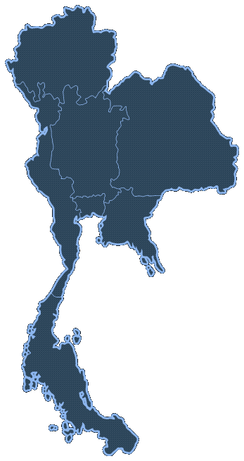
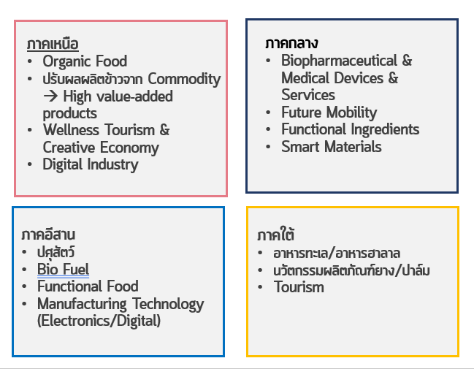
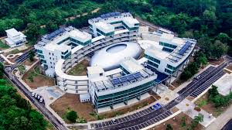
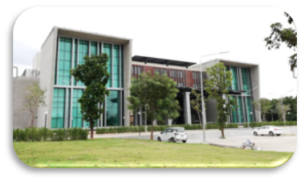
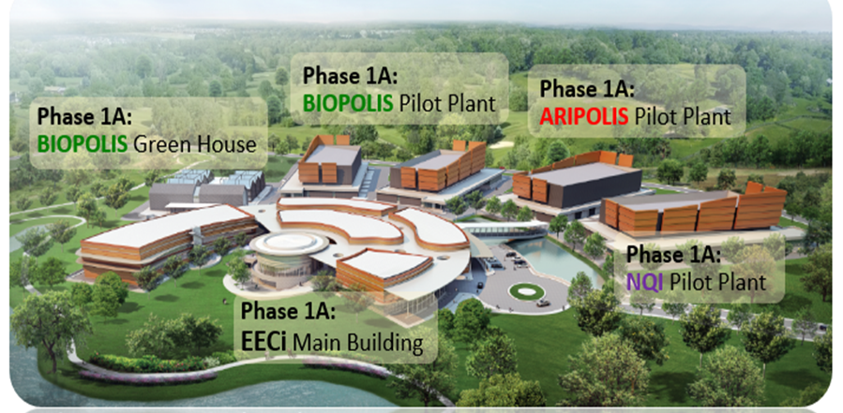
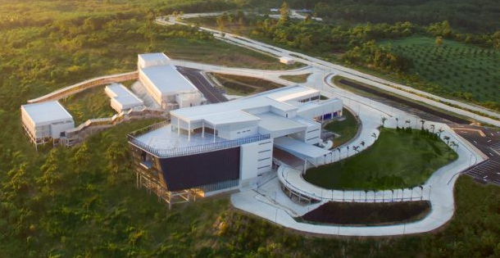
Reaping the Harvest : Science Parks
Northern Science Park (Chiangmai)
Incubate & accelerate the growth of 10,000 business enterprises, including:
Startup
Smart SME
Community-Based Enterprises
North
Organic Food
Rice as a Commodity → High Value-Added Products
Wellness Tourism & Creative Economy
Digital Industry
Central
Biopharmaceutical & Medical Devices/Services
Future Mobility
Functional Ingredients
Smart Materials
CMU
MJU
MFU
UP
URU
NU
PSRU
Northeastern Science Park
(Khon Kaen)
KKU
MSU
UBU
SUT
Thailand Science ParK
(Pathum Thani)
Lower Northeastern Science Park (Nakhon Ratchasima)
Northeastern
Livestock
Biofuels
Functional Food
Manufacturing Technology (Electronics/Digital)
South
Seafood/Halal Food
Rubber-Based Innovation
Tourism
CU
MU
KU
TU
3 KMUTs
EECi : Biopolis,
ARI Polis, Spacepolis
BUU
Southern Science Park (Songkla)
PSU
WU
TSU
Northern
Science Park
Northeastern Science Park
EECi
Southern Science Park
15

Slide 16
HE&I support to enable Thailand to achieve carbon neutrality and net zero emission
16

Slide 17
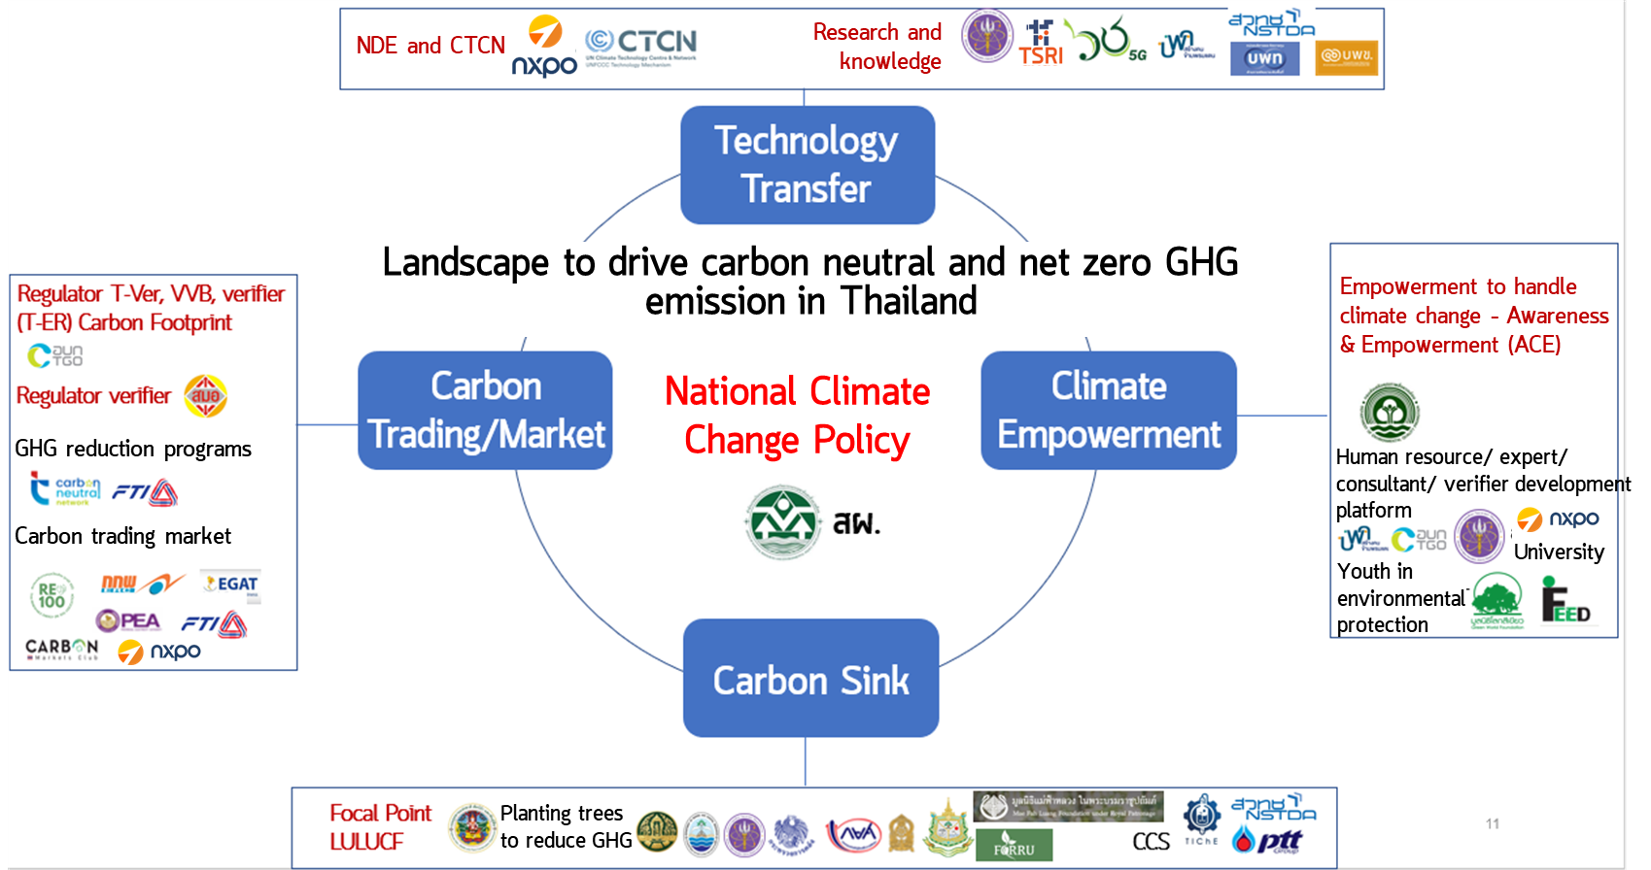
HE&I supporting Ecosystem to achieve
carbon neutrality and net zero emission of GHG
Policy in action
Innovation consortium for decarbonization
Area-based initiative being collaborative with local industry : Saraburi sandbox, Rayong sandbox & Maemoh model
NXPO, TSRI and PMU
co-develop a science research and innovation strategy
Technology transfer mechanism and UNFCCC finance mechanisms
SRI policy recommendation : Partnership mechanism, technology transfer and development mechanism & finance support mechanism
Research &
knowledge creation
17

Slide 18





HE&I support to enable Thailand to achieve carbon neutrality and net zero emission of GHG (5-year plan)
Net Zero Emission Goal (2065)
120 MtCO₂e/Y
(decrese 238 in 45 years)*
Current Total Emission
358 MtCO₂e (2020)
Energy Sector
250.77 MtCO₂e
Agricultural Sector
57.00
MtCO₂e
Industrial Process Sector
32.00
MtCO₂e
Waste Management Sector
18.00 MtCO₂e
Initiatives
decrease 10 MtCO₂e/Y
(after the next 5 years)
3 Pilot Cities
Saraburi/Rayong/Maemoh
(sandbox)
Green
Campus
CVS & HRD
(Carbon Verification Standard
&Human Resource Development)
HESRI Support Program
3 Low Carbon Economic Zones
80 Green Universities
(UI GreenMetric Guidelines)
1,000 Green Experts/
Consultants
100,000 Personnel
Via Training Platform
e.g. Climate Action Academy
30 Climate Tech Transfer programs
(Global & Local)
400 Green Communities
20 Registered
T-VER VVB
(Validation/Verification Body)
50 Green Tech Service Providers
(Business Development Service)
10,000 Companies - Green Improvement
by i-TAP, SUN, TUni, ClinicTech
400 registered
T-VER Projects
300 Companies – Green Tech Adoption
18
*Source: Office of Natural Resources and Environmental Policy and Planning, 2565

Slide 19


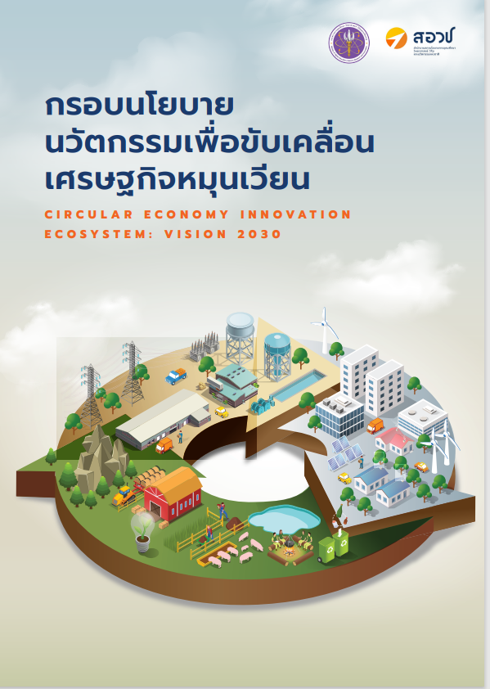

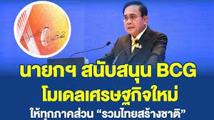







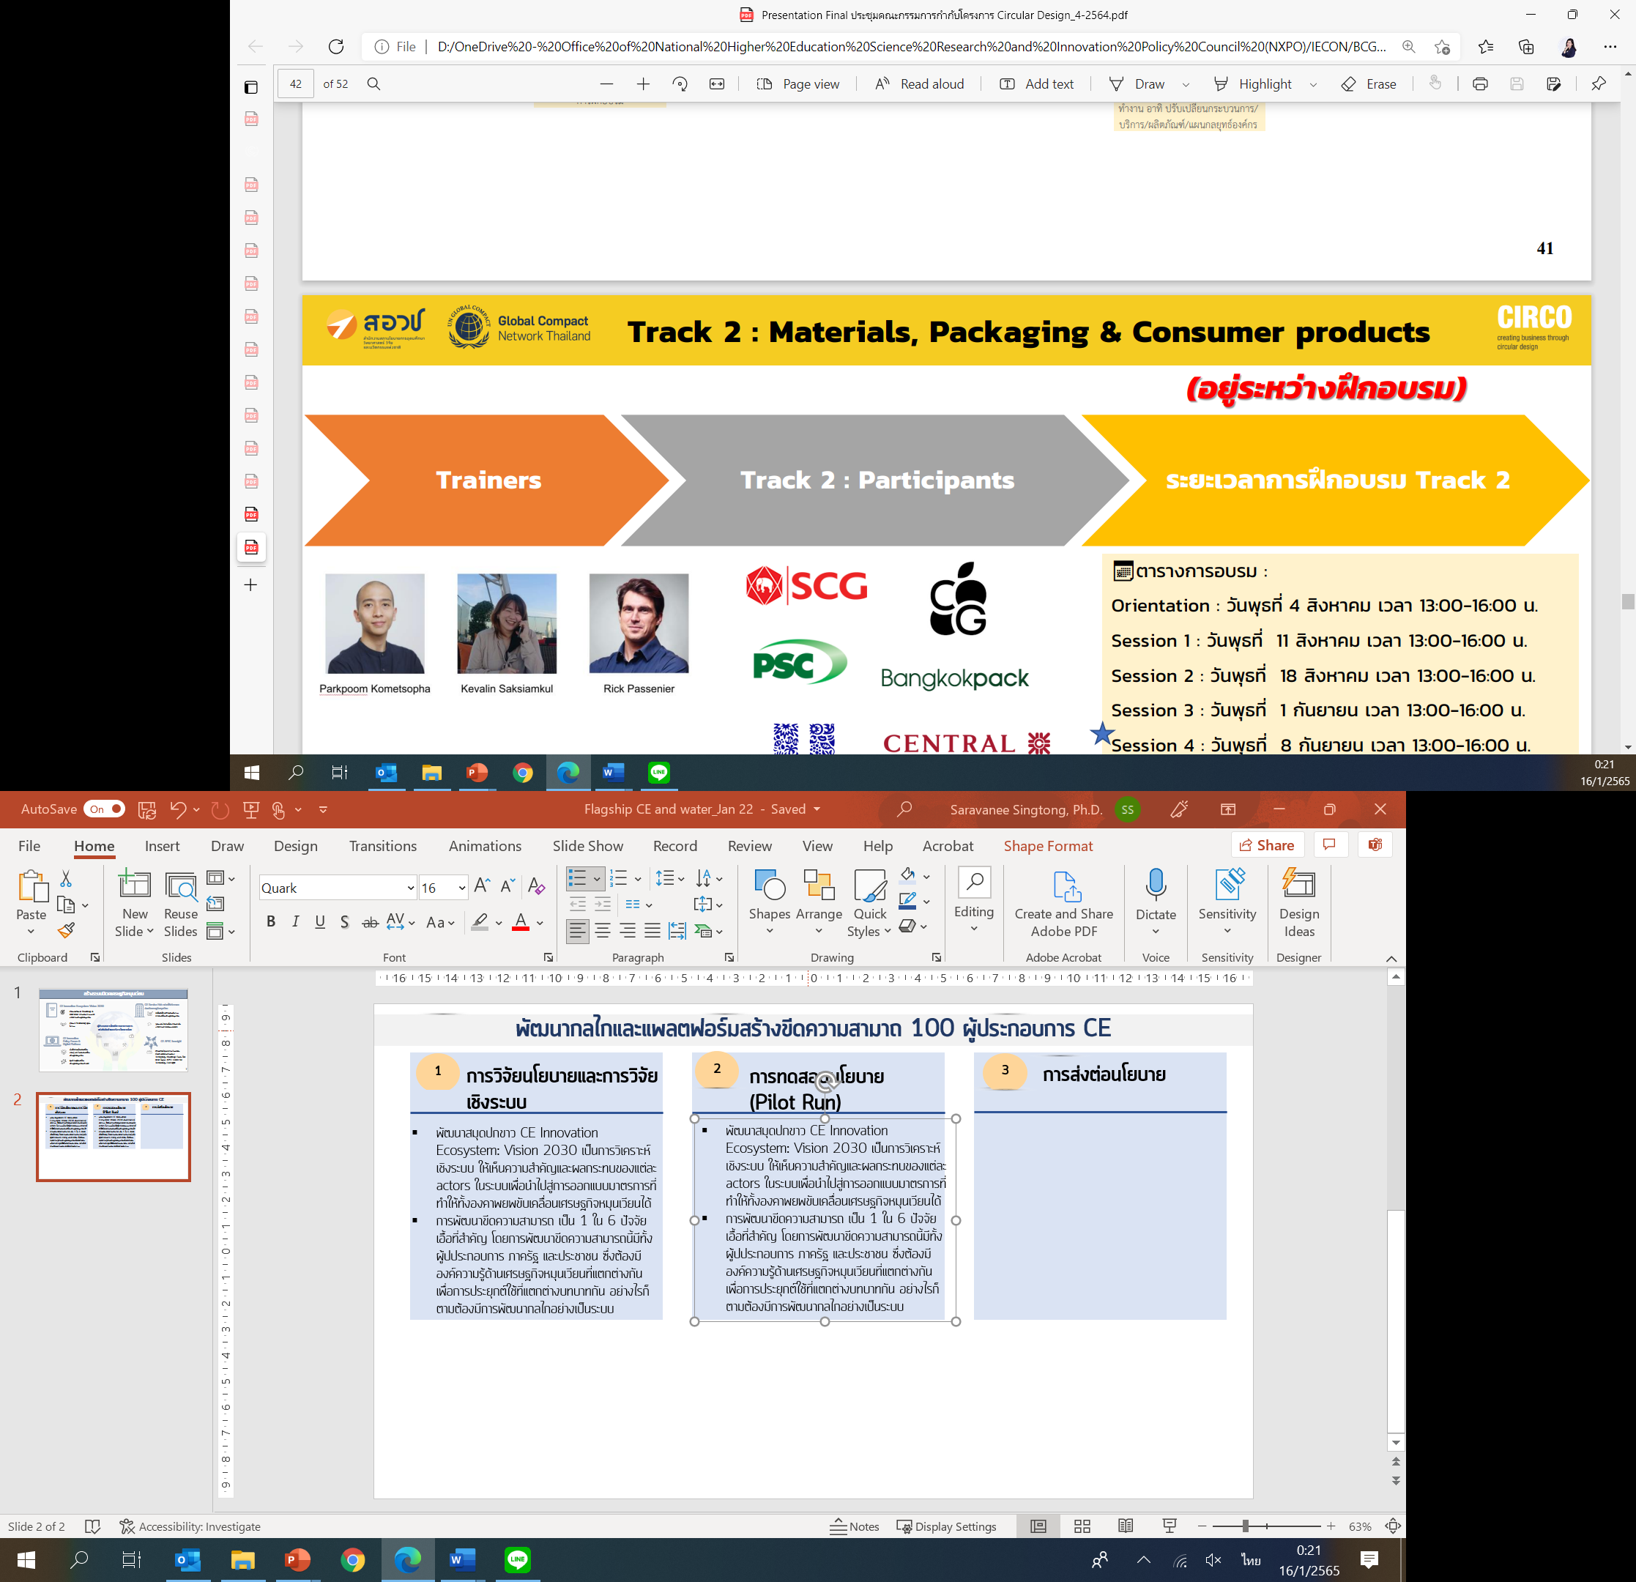
Circular Economy Innovation Ecosystem: Vision 2030
The National Higher Education, Science, Research and Innovation Policy Council (Policy Council)
National Policy
BCG Model
Implementation platform
CE Solution Platform
Circular Design Platform
To support 35 projects with more than 200 MB under
4 sub-projects :
1. CE Platform
2. CE Champion
3. CE RDI
4. CE Enabler
Development of 100 enterprises in 8 Sectors e.g., food, construction and packaging to accomplish circular economy in the business development plan
Expanding the OSMEP incentives to enhance SMEs performance
19

Slide 20
Social Mobility and Targeting Poverty Eradication
20

Slide 21

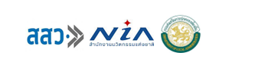
























Social Mobility and Targeting Poverty Eradication
Rural Entrepreneurship Development
To unlock entrepreneurial potential of local people by applying knowledge, technology and innovation
To develop infrastructure and industry to create a new growth pole of country
To upward social mobility of 1 million vulnerable people in 2027
Income
Education Promotion
1 million
people
In 2027
Education
Workforce Development
Social Mobility
WELL-BEING
vulnerable target group
Rural Area
Marginalized Youth
Urban Poor
Gig Workers
State Welfare Card Holders
Health Promotion
Health
Social Welfare System
ACCESSIBILITY TO
PUBLIC SERVICES
21

Slide 22

Social Mobility: 1 Million Vulnerable People in 2027
1 Million Vulnerable People in 2027
Community Entrepreneurship Development
3
Community Entrepreneurship Development by University coaching
Promotion of specialty markets for local products
Business Incubator Center
Facilitating a network to support entrepreneur
Manpower Development
2
Reskill/Upskill → Premium workers
Financial support Matching for wage & training with private sector
Job creation
Career-based Education
1
Scholarship for young talents/ children in poor households with mentoring system
State education card provide financial assistance
Funding/Tax incentive for company & NGOs
22

Slide 23
Higher Education Transformation
for High-skilled Workforce Development
to Support Strategic Industries and Frontier Research
23

Slide 24






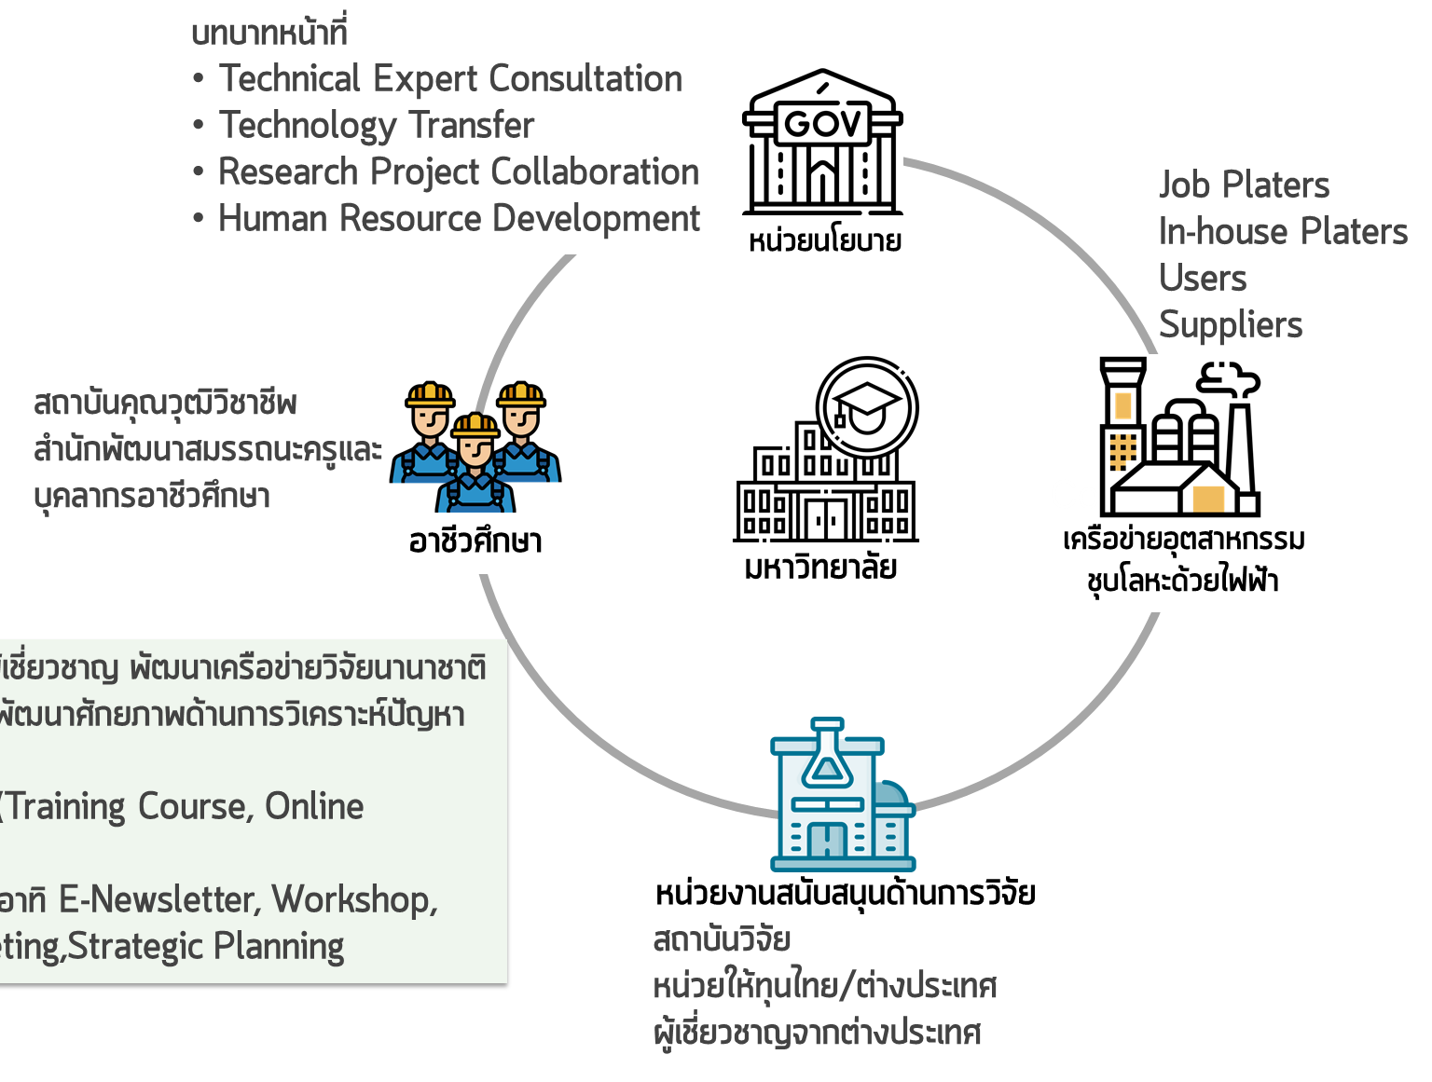
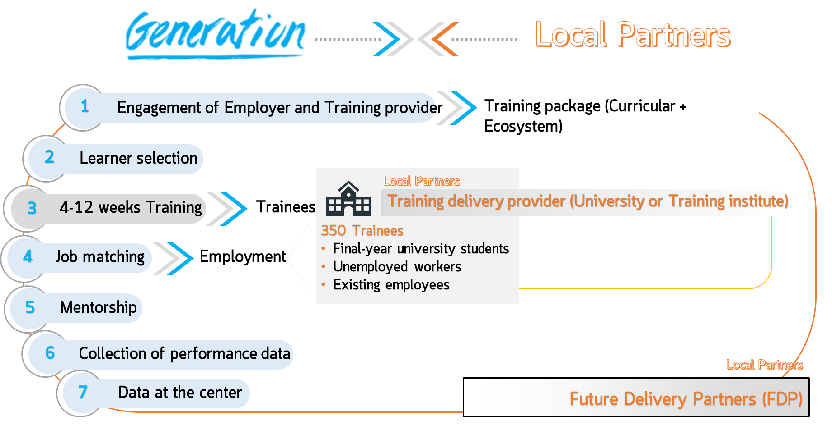
New Model for High-skilled Workforce Development
to Support Strategic Industries
Job Matching & Employment
Employer- Training Provider (GenNX Model)
HE Sandbox
Educational Innovation
Industrial
Tailor-made Vocational Training
Future Skill Platform
Massive Access
Intensive upskill & reskill program belonging to job requirement
Job Matching : Job seeker-Employer
Co-design upskilling course by employer
Short intensive bootcamp for 4-12 weeks
Unlocking the restricted rules to create educational innovation in higher education
Preparing graduates having competencies that meet country/industry needs
Elevating expert’s capability to solve problems and develop research in the manufacturing and service sectors.
Example :
Thailand Electroplating Professional Network; TEPNET model
System change of manpower development via seamless linkage between university and private sector
Career Growth Opportunity
  Providing competencies requirement in each job position
  Job details & Expert sharing
Assessment Center
  Skill gap assessment to design individual learning pathway
Learning Program
(Co-creation)
  Digital Learning
  Virtual Learning
  Action Learning
Example:
Examples of Innovation in higher education
Competency-based education
New curriculum structure
University consortium for resource sharing
Enterprise consortium: connecting between demand & supply
University & professional council collaboration
Example
Junior Software Developer
Elder Caregiver
High-skilled workforce produced via HE sandbox (examples)
Digital, AI, Cybersecurity
High-tech Entrepreneur
Frontier Scientist
Paramedicine
24

Slide 25






Tax Incentive related to Manpower Development :
Thailand Plus Package
Hiring highly skilled employees in STEM
Training for personnel development in STEM
Companies in targeted industries that hire new STEM employees can apply for a 150% income tax exemption.
Companies that support employees for training in courses accredited by MHESI can be applied for a 250% income tax exemption.
Certified 1,329 positions from 53 companies
Certified 528 courses from 50 training providers
Number of companies
Benefits
608
Total income
In 2022
360
million THB
Consolidated income tax
4.7
million THB
Number of trainees
15,388
Company
Tax deductions have been made.
36
million THB
Company
Tax deductions have been made.
51.9
million THB
Training costs
173
million THB
25

Slide 26



Skill-Future Wallet: Policy Proposal
Target group
Skill Future Account
Outcomes
Manpower & Brainpower Development related to Demand-side
1,000,000 persons
Training fee support via “E-Wallet”
10,000 Bath For 1,000,000 persons
Focusing on Future Skills
Digital
Data Analytic
Creative
Technology
Marketing & Business Development
To enhance the investment form
domestic and FDI
To Maintain high-skilled employment and support the economic growth
To strengthen the potential of entrepreneurs raising the social status of grassroots
Undergraduate student
(1.6 million persons by 2021)
80,000 persons
STEM workforce
(16.7 million persons by 2021)
640,000 persons
Grassroots people
(4.3 million persons by 2021)
280,000 persons
26

Slide 27
Frontier Research to Foster Innovation to Create Future Growth Engines
  Set goals and directions of medium to long-term investment
  Build and attract talents for supporting future industries
  Cooperate with other countries in big science and global frontier research projects
Quantum Technology
High Energy Physics
Hydrogen Fuel
Genomics/Omics
Monoclonal/Biologic/Vaccine
Earth-Space System
SAFE BET
HIGH-RISK,
HIGH RETURN
Future Food/
Novel Food
Plant-based Protein
Flavor
Synthetic Biology
CCUS
(Carbon Capture,
Utilization & Storage)
Cultured Meat
27

Slide 28




Thank You
https://www.facebook.com/NXPOTHAILAND
NXPO - สอวช.
https://twitter.com/NXPO_TH
info@nxpo.or.th

